Slide 1
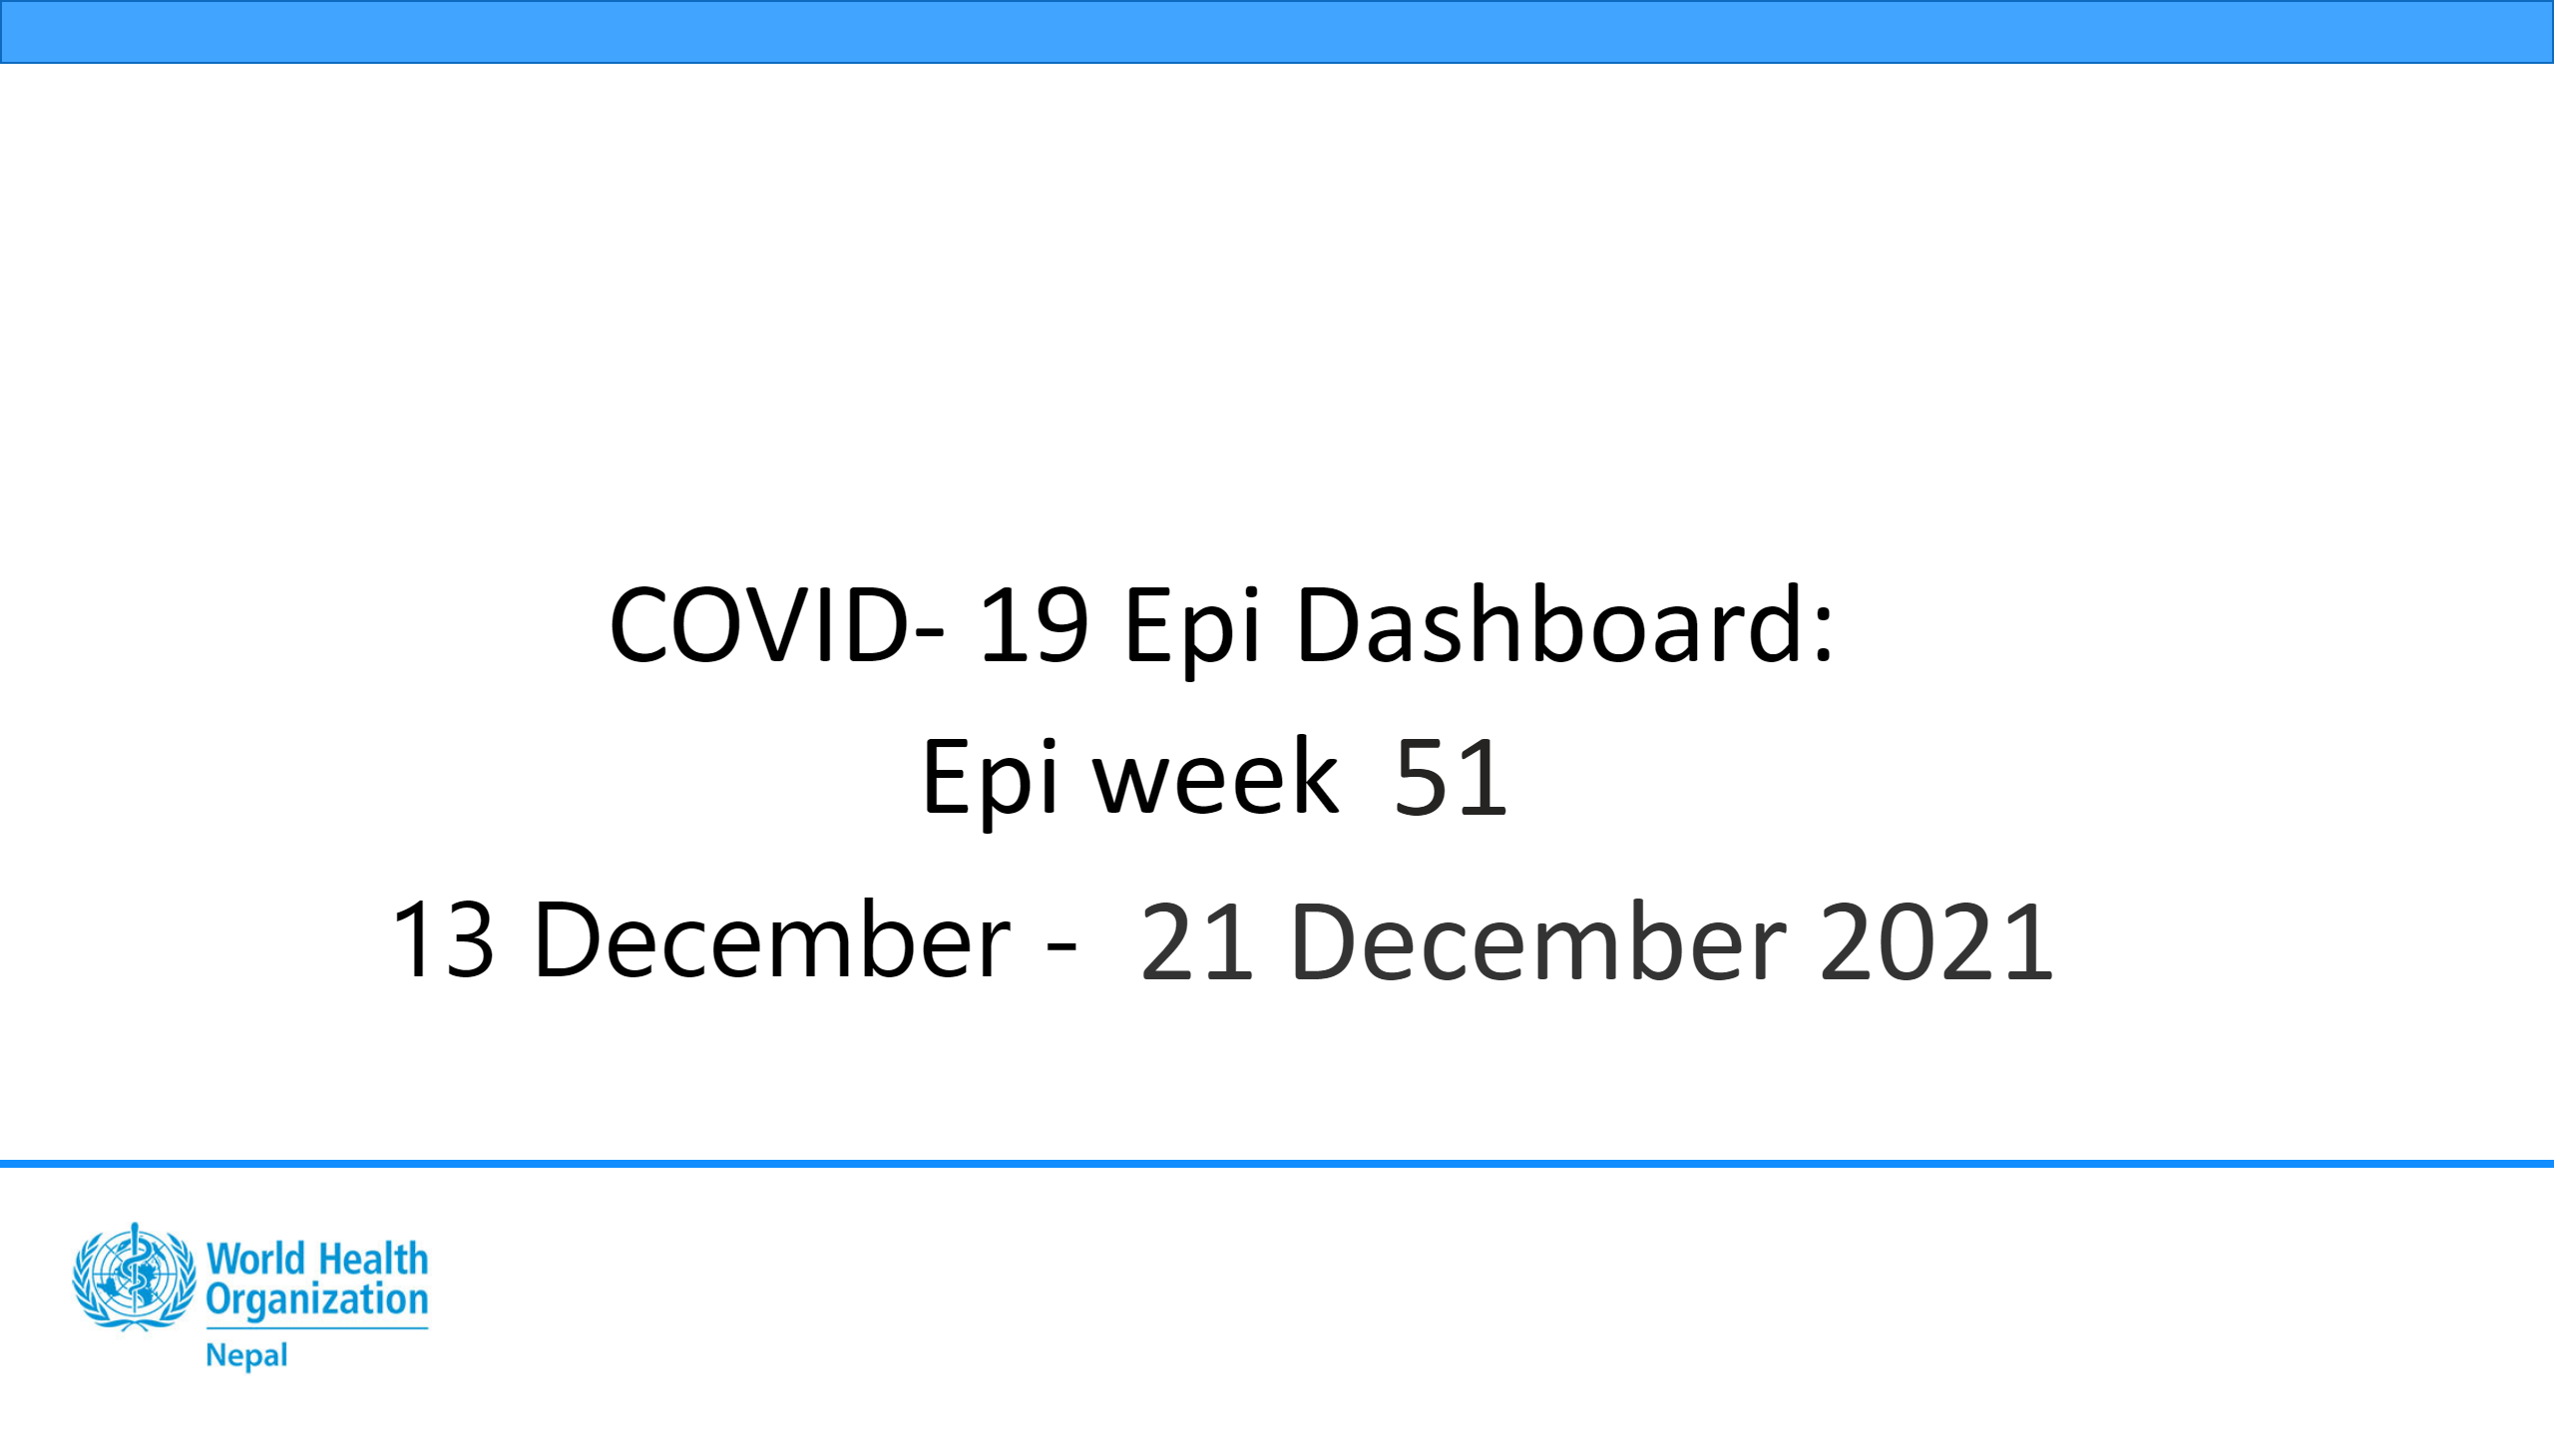
Cover
Notes:
card
No alt text provided
textbox
No alt text provided
textbox
No alt text provided
card
No alt text provided
shape
No alt text provided
shape
No alt text provided
image
No alt text provided
textbox
No alt text provided

Slide 2
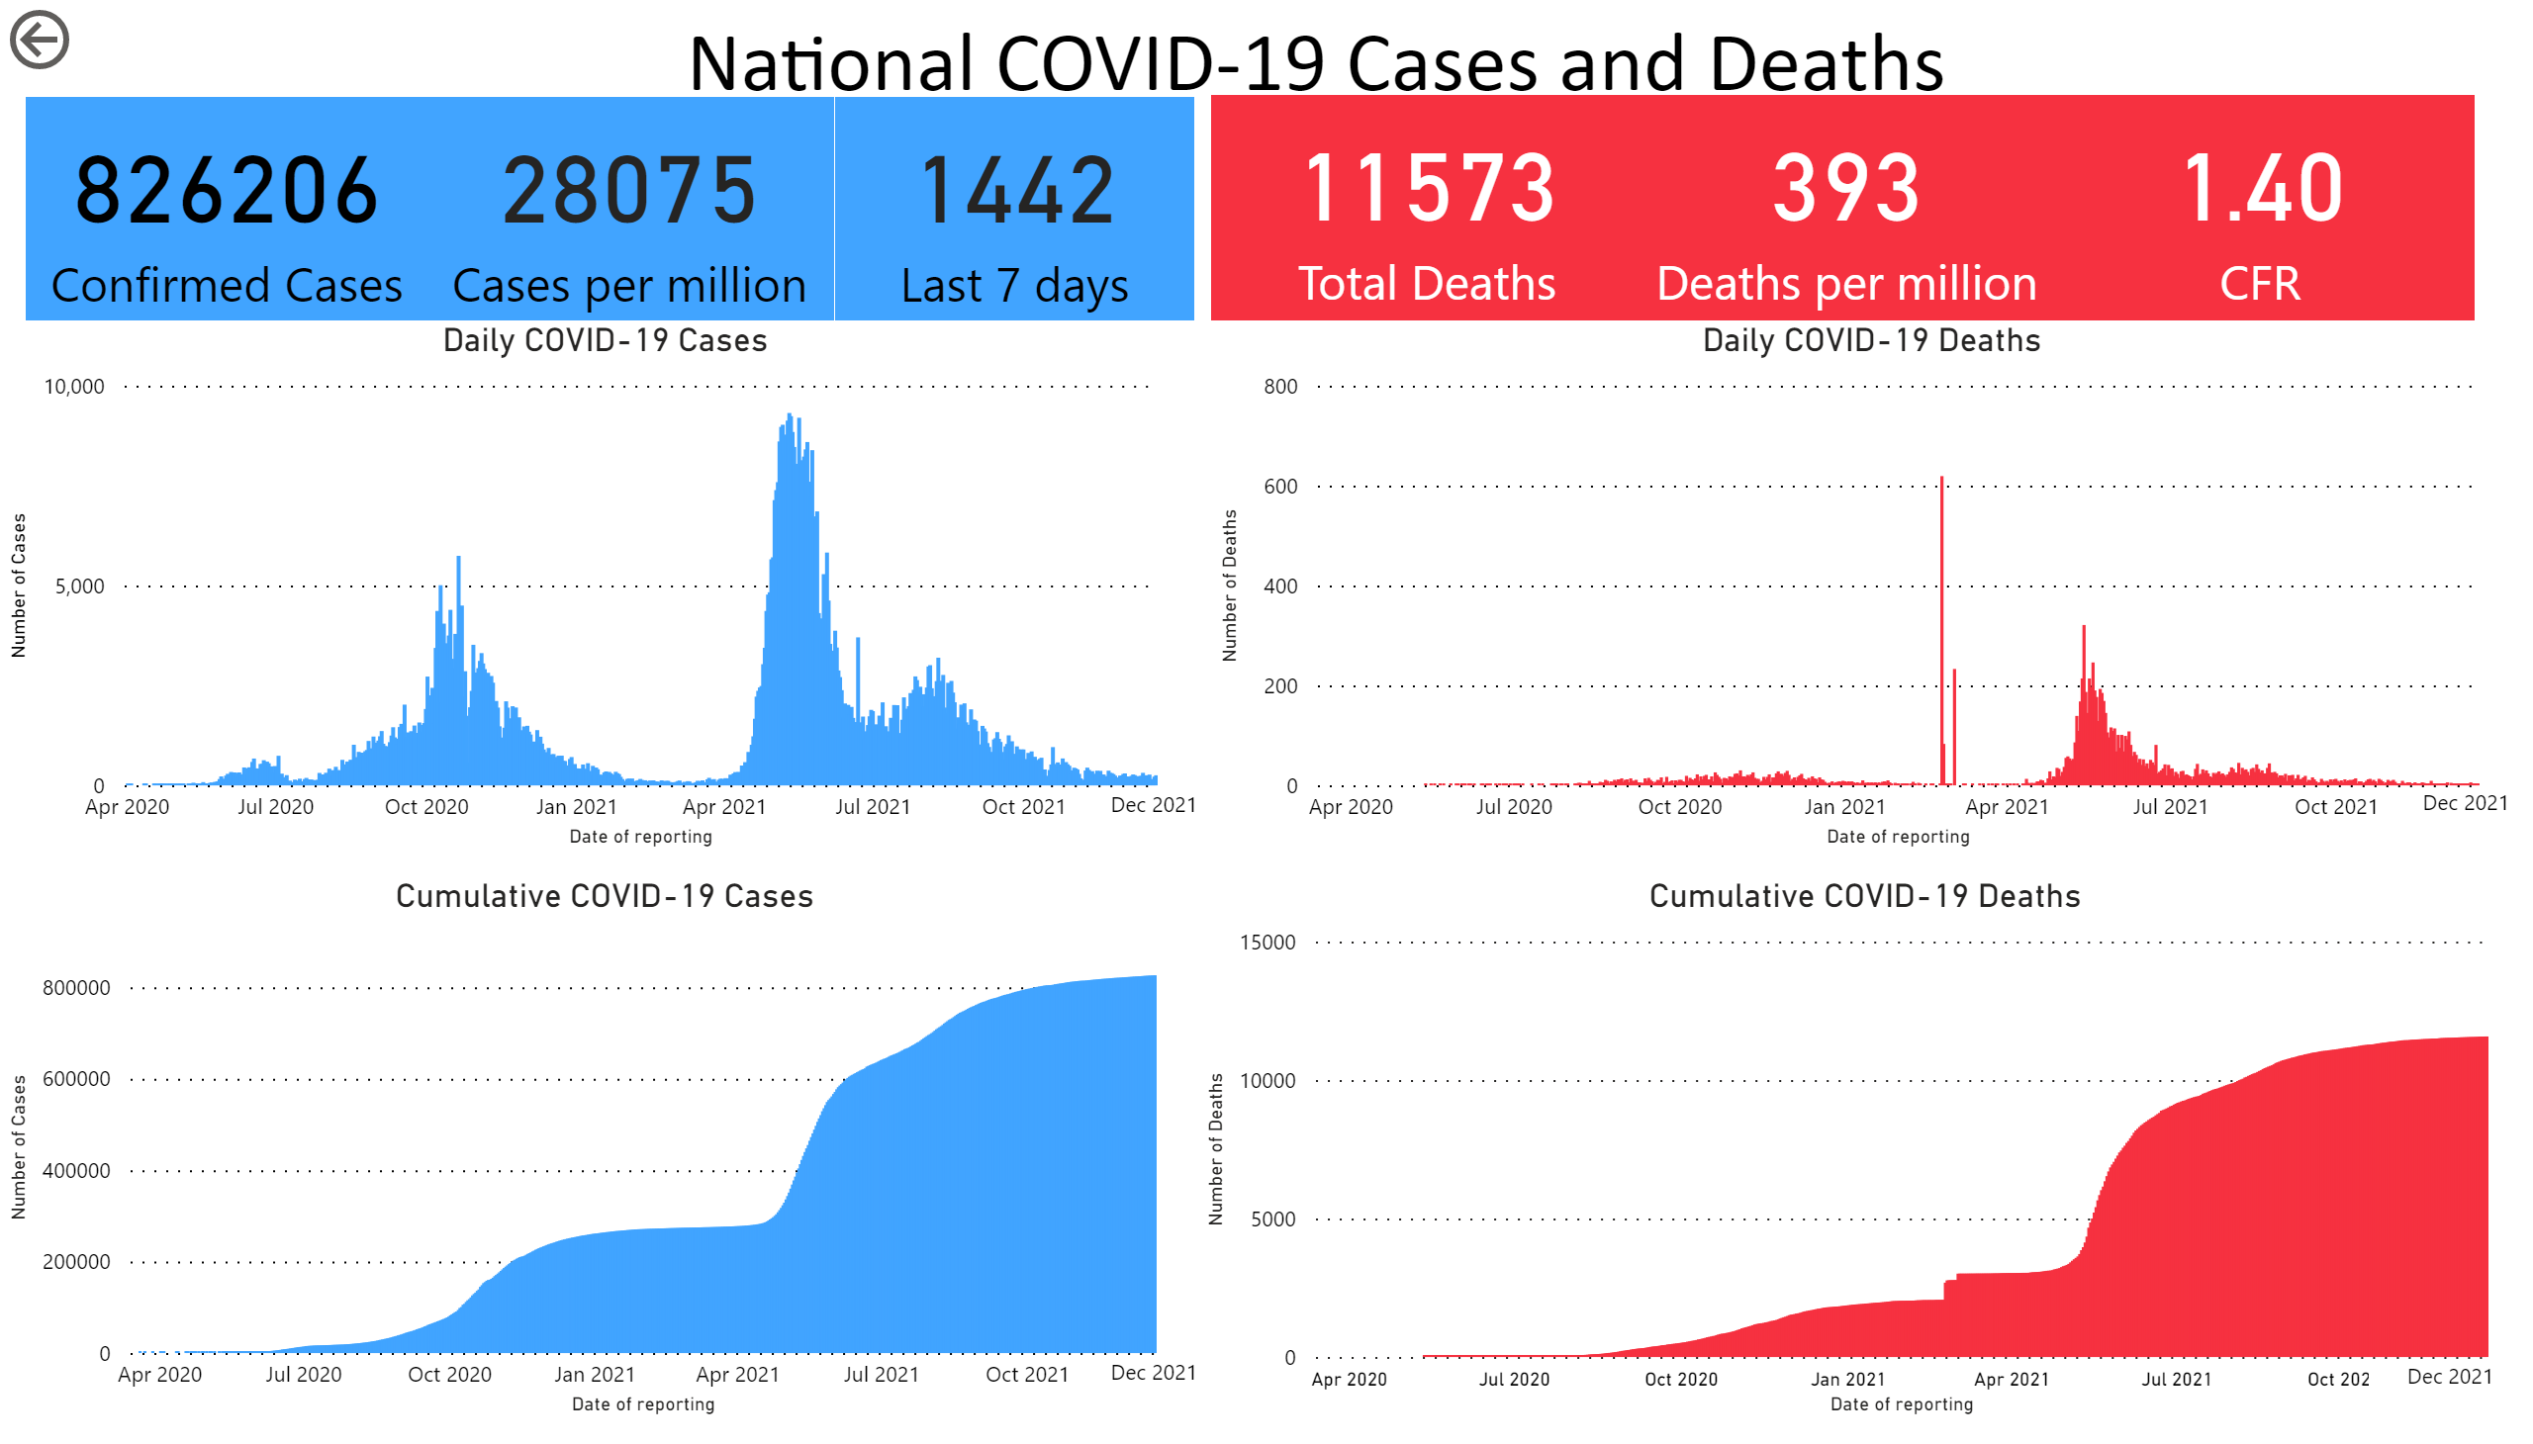
National
Notes:
textbox
No alt text provided
card
No alt text provided
card
No alt text provided
card
No alt text provided
Cumulative COVID-19 Cases
No alt text provided
Daily COVID-19 Deaths
No alt text provided
Cumulative COVID-19 Deaths
No alt text provided
Daily COVID-19 Cases
No alt text provided
shape
No alt text provided
shape
No alt text provided
shape
No alt text provided
shape
No alt text provided
actionButton
No alt text provided
card
No alt text provided
card
No alt text provided
card
No alt text provided

Slide 3
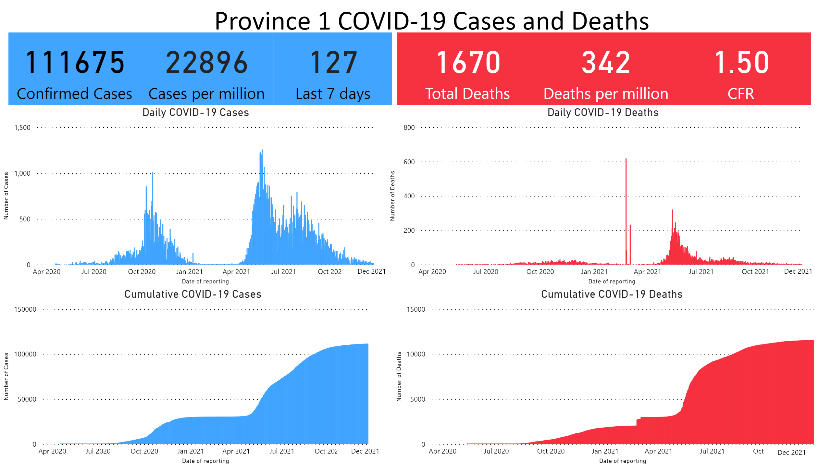
Province1
Notes:
textbox
No alt text provided
card
No alt text provided
card
No alt text provided
card
No alt text provided
card
No alt text provided
card
No alt text provided
card
No alt text provided
Daily COVID-19 Cases
No alt text provided
Daily COVID-19 Deaths
No alt text provided
Cumulative COVID-19 Deaths
No alt text provided
Cumulative COVID-19 Cases
No alt text provided
shape
No alt text provided
shape
No alt text provided
shape
No alt text provided
shape
No alt text provided

Slide 4
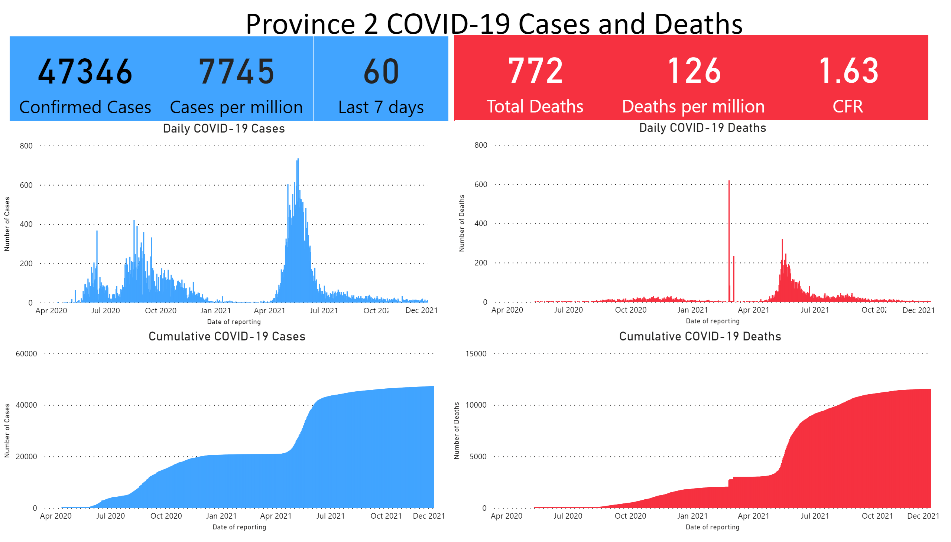
Province 2
Notes:
textbox
No alt text provided
card
No alt text provided
card
No alt text provided
card
No alt text provided
card
No alt text provided
card
No alt text provided
card
No alt text provided
Daily COVID-19 Cases
No alt text provided
Daily COVID-19 Deaths
No alt text provided
Cumulative COVID-19 Deaths
No alt text provided
Cumulative COVID-19 Cases
No alt text provided
shape
No alt text provided
shape
No alt text provided
shape
No alt text provided
shape
No alt text provided

Slide 5
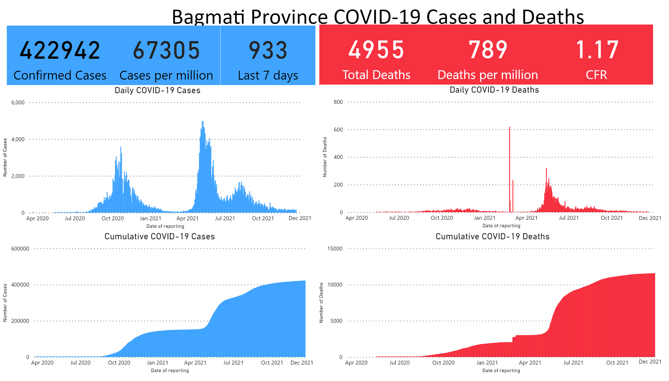
Bagmati
Notes:
textbox
No alt text provided
card
No alt text provided
card
No alt text provided
card
No alt text provided
card
No alt text provided
card
No alt text provided
card
No alt text provided
Daily COVID-19 Cases
No alt text provided
Daily COVID-19 Deaths
No alt text provided
Cumulative COVID-19 Cases
No alt text provided
Cumulative COVID-19 Deaths
No alt text provided
shape
No alt text provided
shape
No alt text provided
shape
No alt text provided
shape
No alt text provided

Slide 6
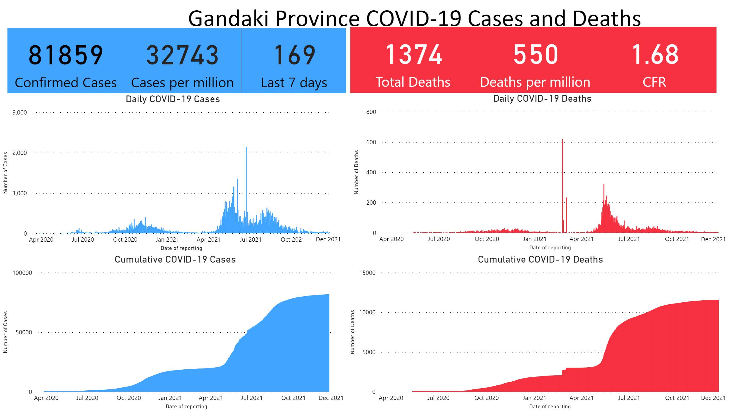
Gandaki
Notes:
textbox
No alt text provided
card
No alt text provided
card
No alt text provided
card
No alt text provided
card
No alt text provided
card
No alt text provided
card
No alt text provided
Daily COVID-19 Cases
No alt text provided
Daily COVID-19 Deaths
No alt text provided
Cumulative COVID-19 Deaths
No alt text provided
Cumulative COVID-19 Cases
No alt text provided
shape
No alt text provided
shape
No alt text provided
shape
No alt text provided
shape
No alt text provided

Slide 7
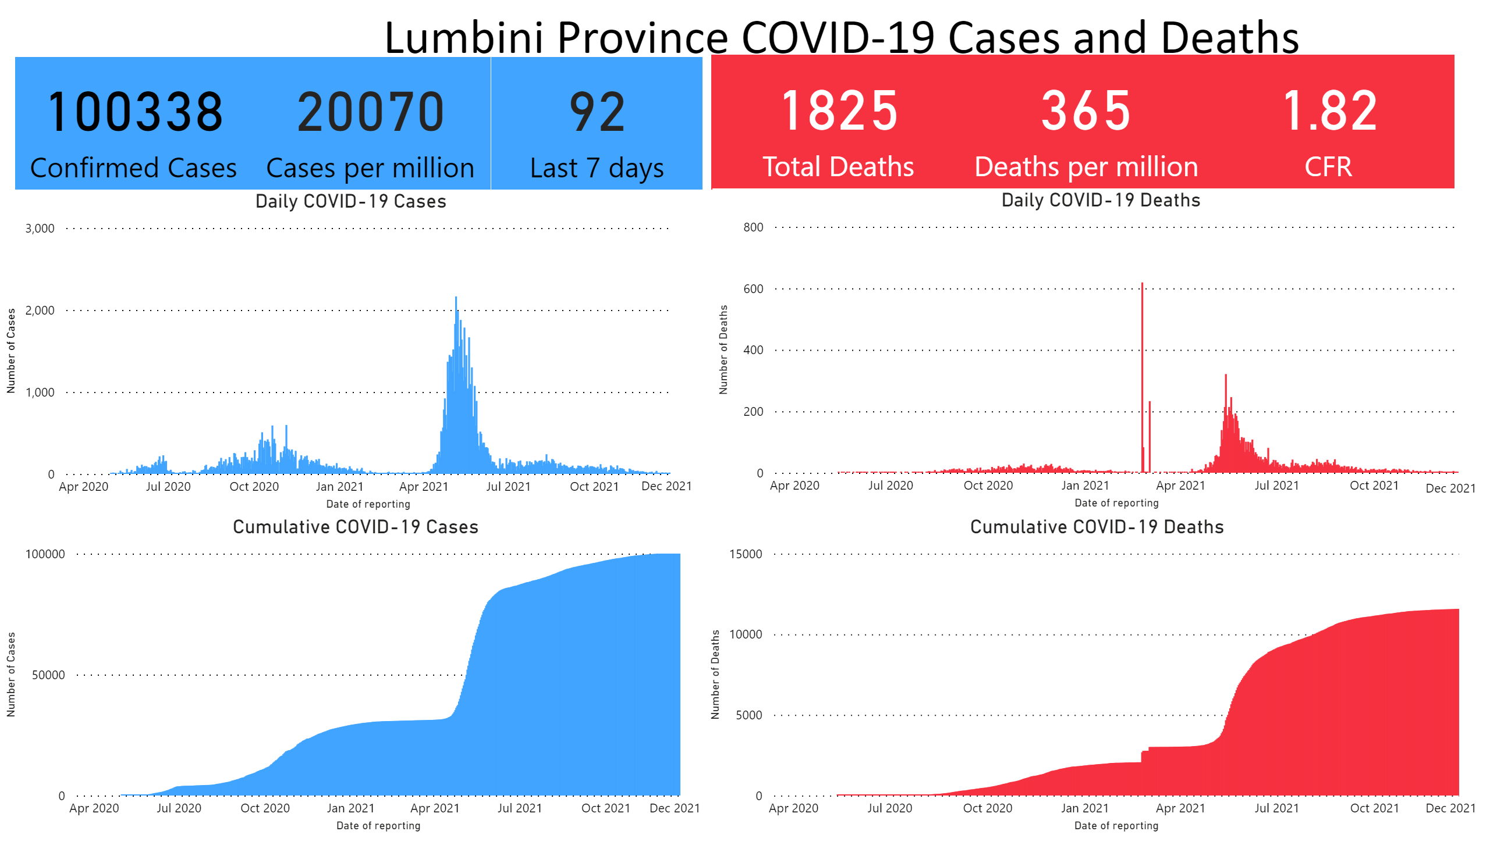
Lumbini
Notes:
textbox
No alt text provided
card
No alt text provided
card
No alt text provided
card
No alt text provided
card
No alt text provided
card
No alt text provided
card
No alt text provided
Daily COVID-19 Cases
No alt text provided
Daily COVID-19 Deaths
No alt text provided
Cumulative COVID-19 Cases
No alt text provided
Cumulative COVID-19 Deaths
No alt text provided
shape
No alt text provided
shape
No alt text provided
shape
No alt text provided
shape
No alt text provided

Slide 8
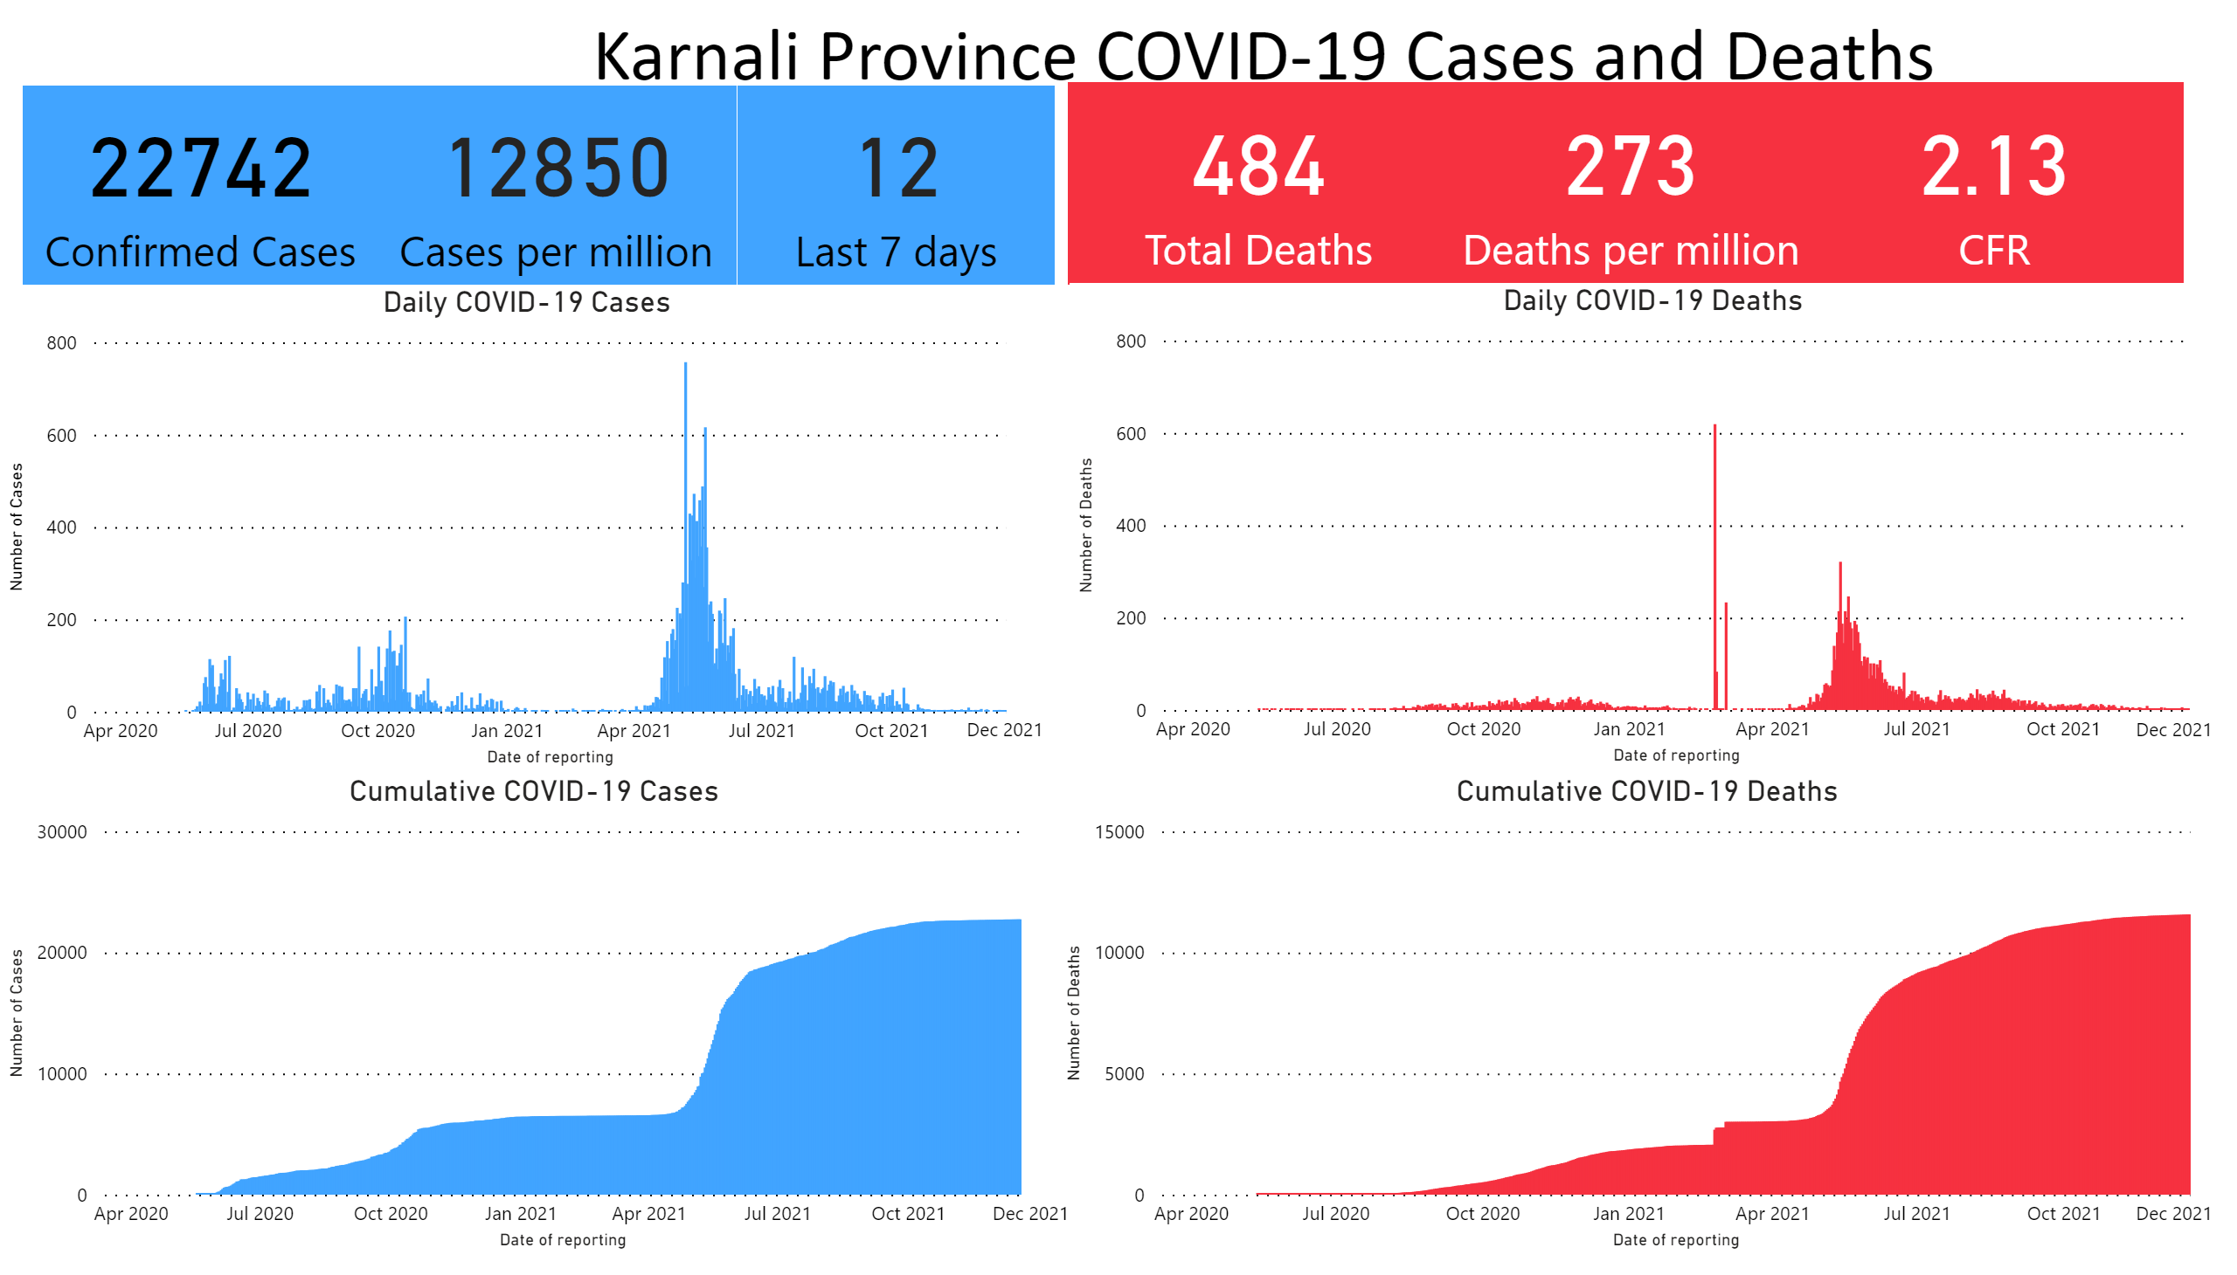
Karnali
Notes:
textbox
No alt text provided
card
No alt text provided
card
No alt text provided
card
No alt text provided
card
No alt text provided
card
No alt text provided
card
No alt text provided
Daily COVID-19 Cases
No alt text provided
Daily COVID-19 Deaths
No alt text provided
Cumulative COVID-19 Cases
No alt text provided
Cumulative COVID-19 Deaths
No alt text provided
shape
No alt text provided
shape
No alt text provided
shape
No alt text provided
shape
No alt text provided

Slide 9
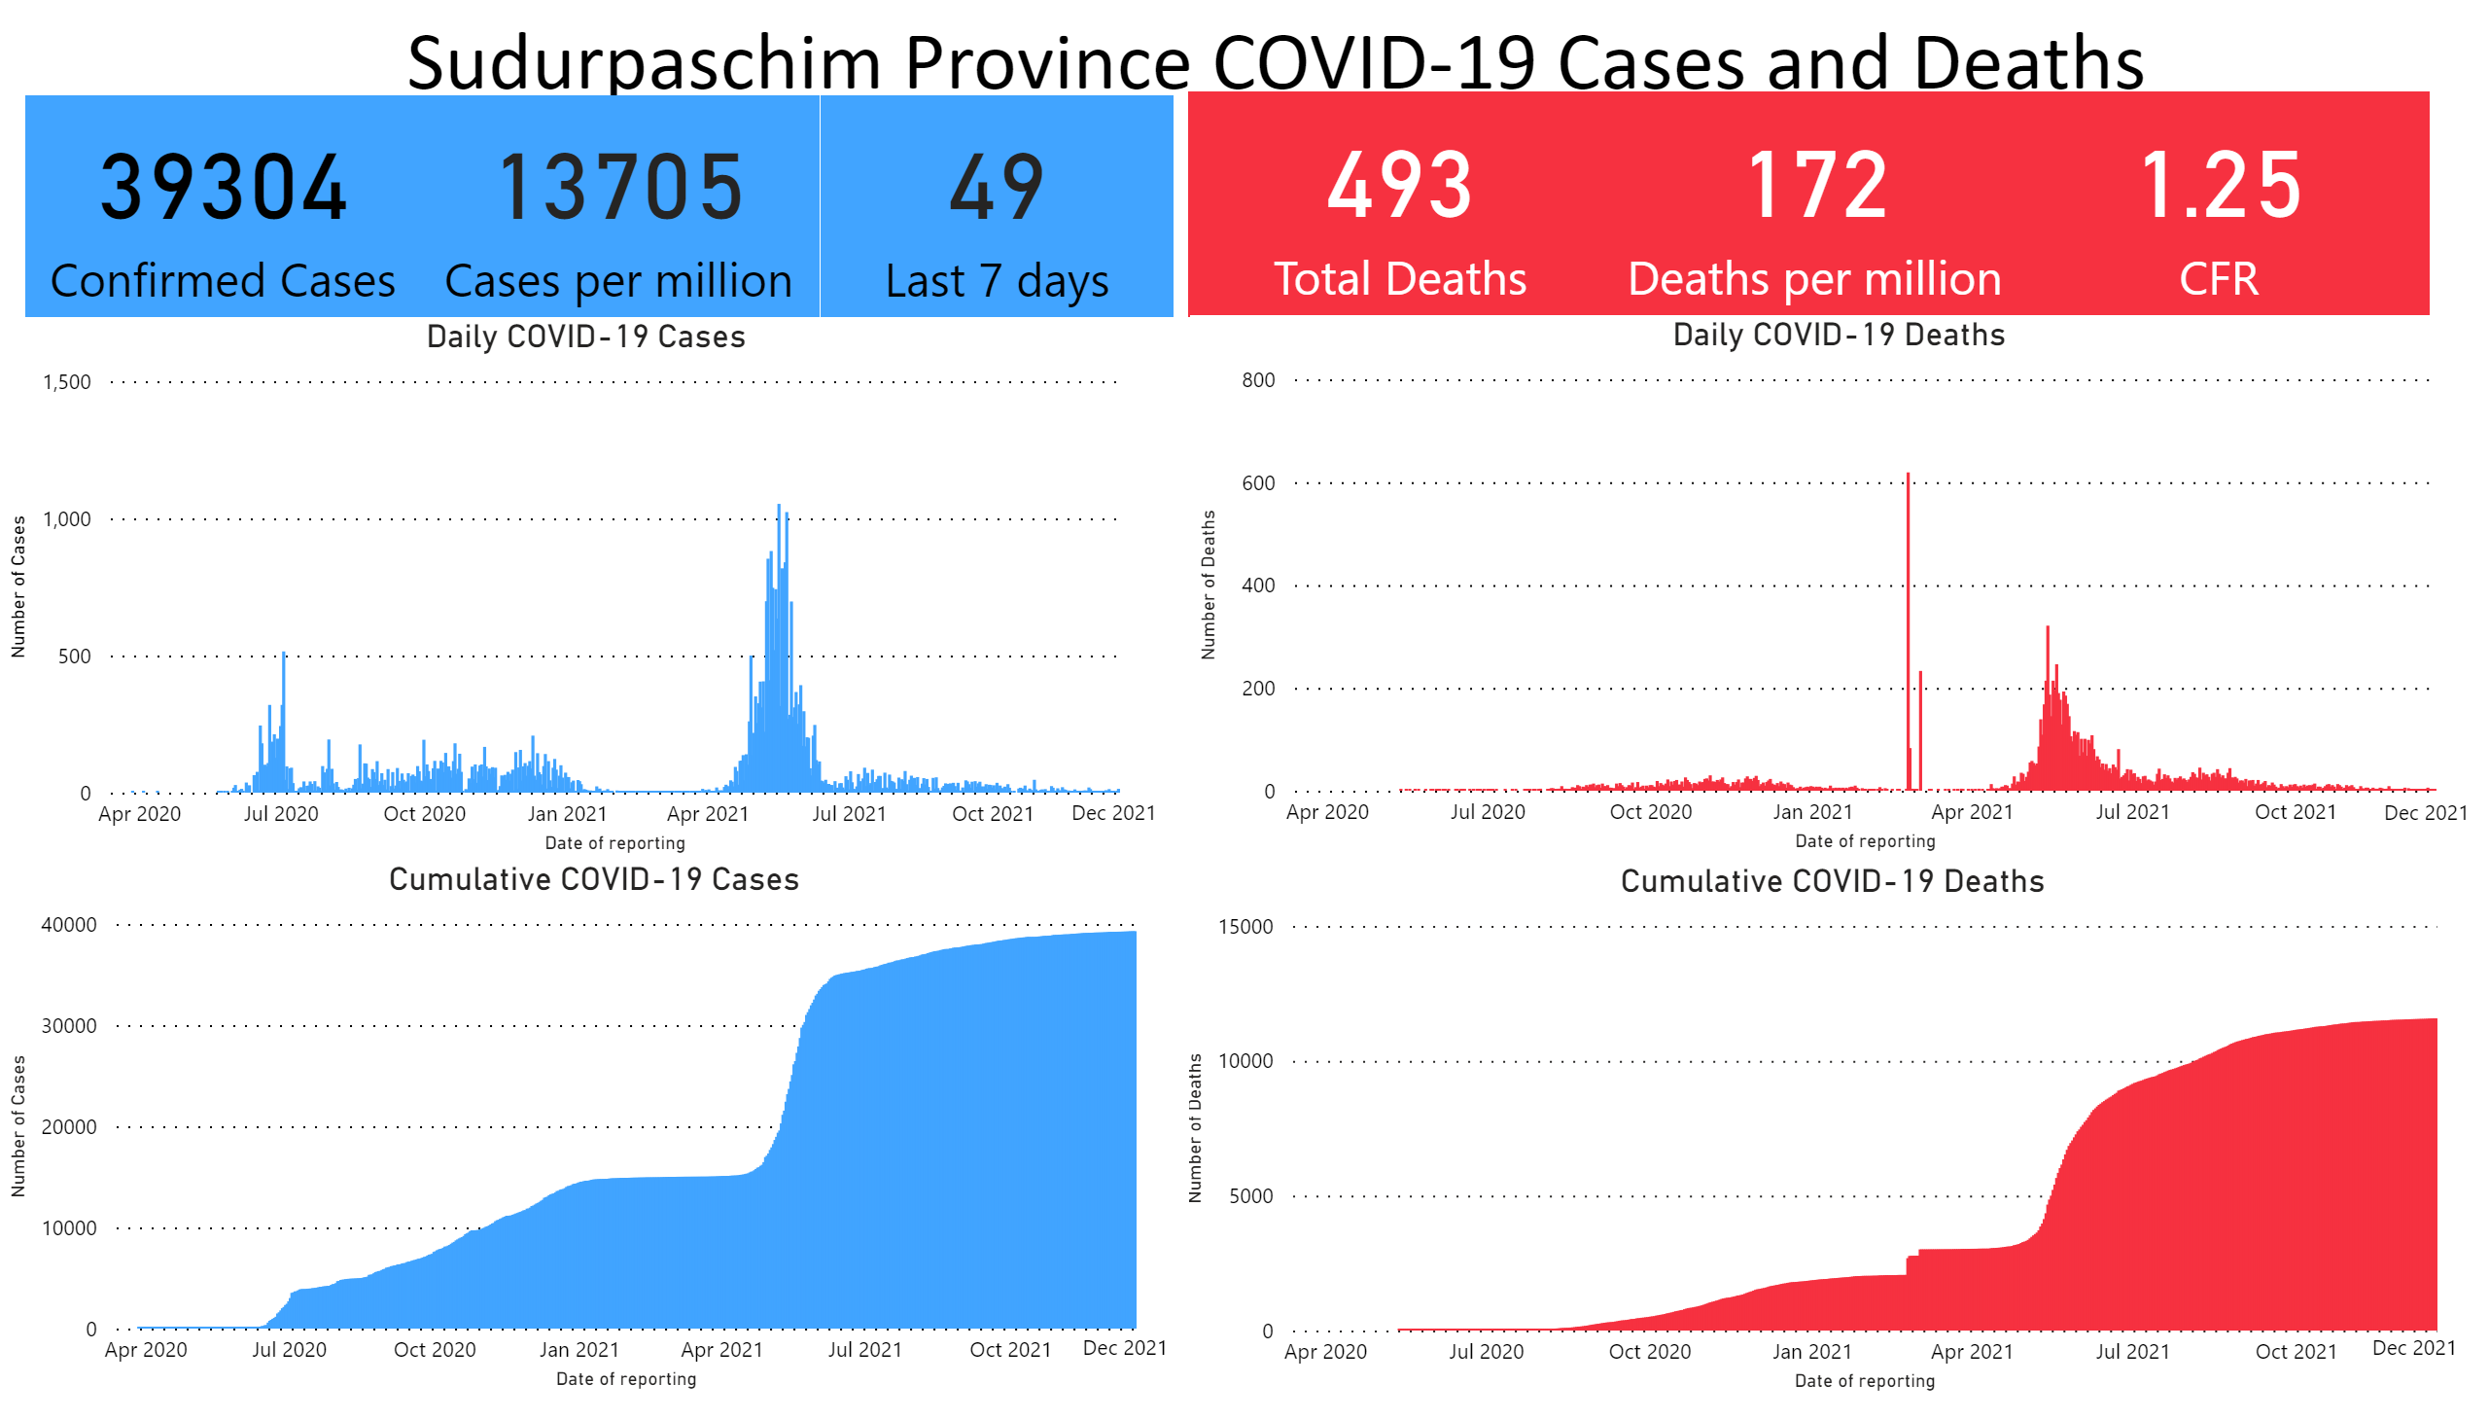
SudurPaschim
Notes:
textbox
No alt text provided
card
No alt text provided
card
No alt text provided
card
No alt text provided
card
No alt text provided
card
No alt text provided
card
No alt text provided
Cumulative COVID-19 Deaths
No alt text provided
Daily COVID-19 Deaths
No alt text provided
Daily COVID-19 Cases
No alt text provided
Cumulative COVID-19 Cases
No alt text provided
shape
No alt text provided
shape
No alt text provided
shape
No alt text provided
shape
No alt text provided

Slide 10
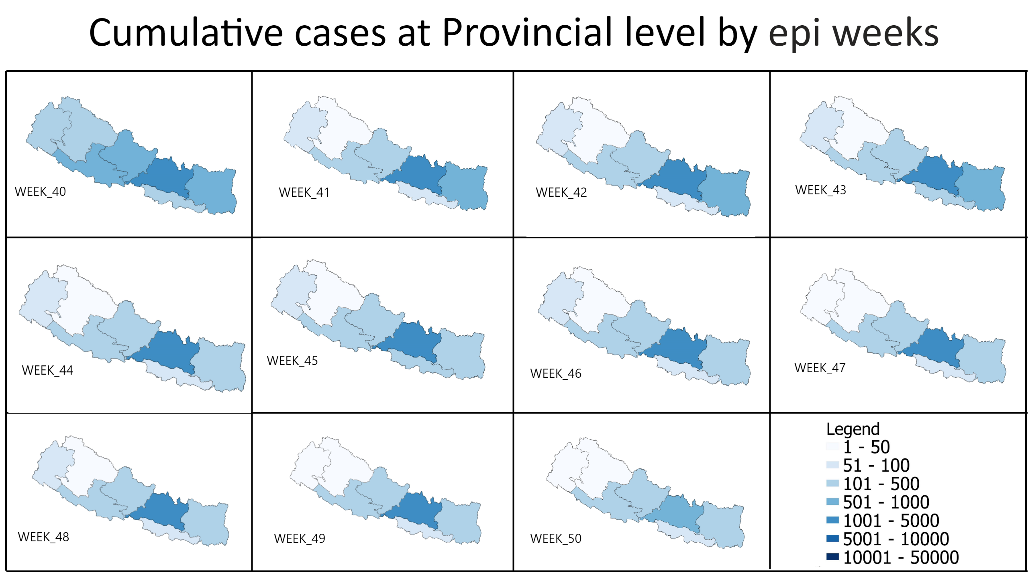
cumulative cases
Notes:
shape
No alt text provided
shape
No alt text provided
shape
No alt text provided
shape
No alt text provided
shape
No alt text provided
textbox
No alt text provided
shape
No alt text provided
image
No alt text provided
textbox
No alt text provided
image
No alt text provided
textbox
No alt text provided
image
No alt text provided
textbox
No alt text provided
image
No alt text provided
textbox
No alt text provided
image
No alt text provided
textbox
No alt text provided
image
No alt text provided
textbox
No alt text provided
image
No alt text provided
textbox
No alt text provided
image
No alt text provided
shape
No alt text provided
shape
No alt text provided
shape
No alt text provided
textbox
No alt text provided
image
No alt text provided
textbox
No alt text provided
image
No alt text provided
image
No alt text provided
textbox
No alt text provided
textbox
No alt text provided
image
No alt text provided

Slide 11
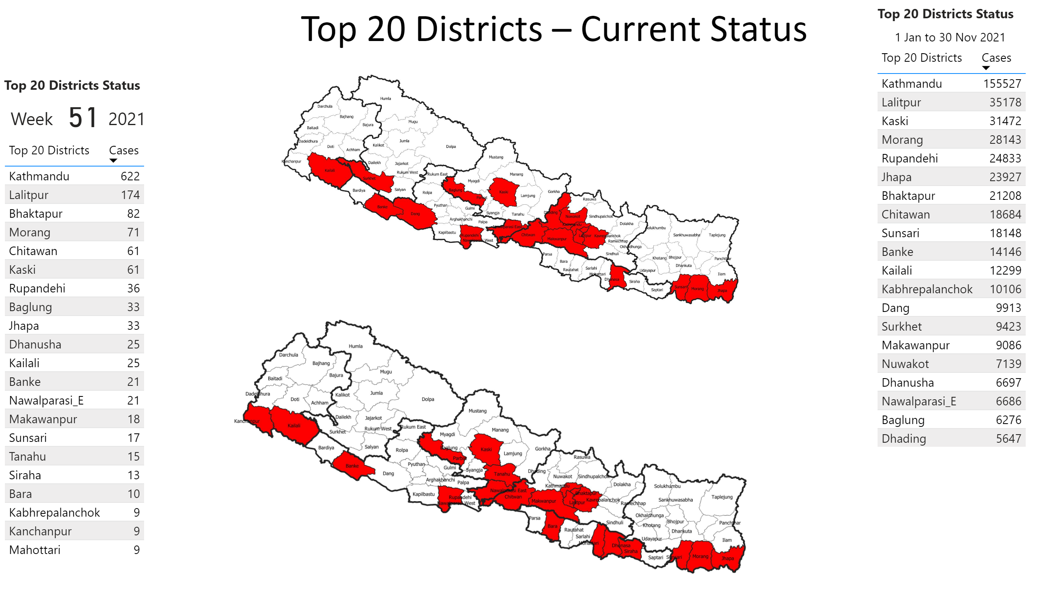
Top 20 Districts
Notes:
textbox
No alt text provided
tableEx
No alt text provided
card
No alt text provided
textbox
No alt text provided
textbox
No alt text provided
textbox
No alt text provided
image
No alt text provided
textbox
No alt text provided
textbox
No alt text provided
tableEx
No alt text provided
image
No alt text provided

Slide 12
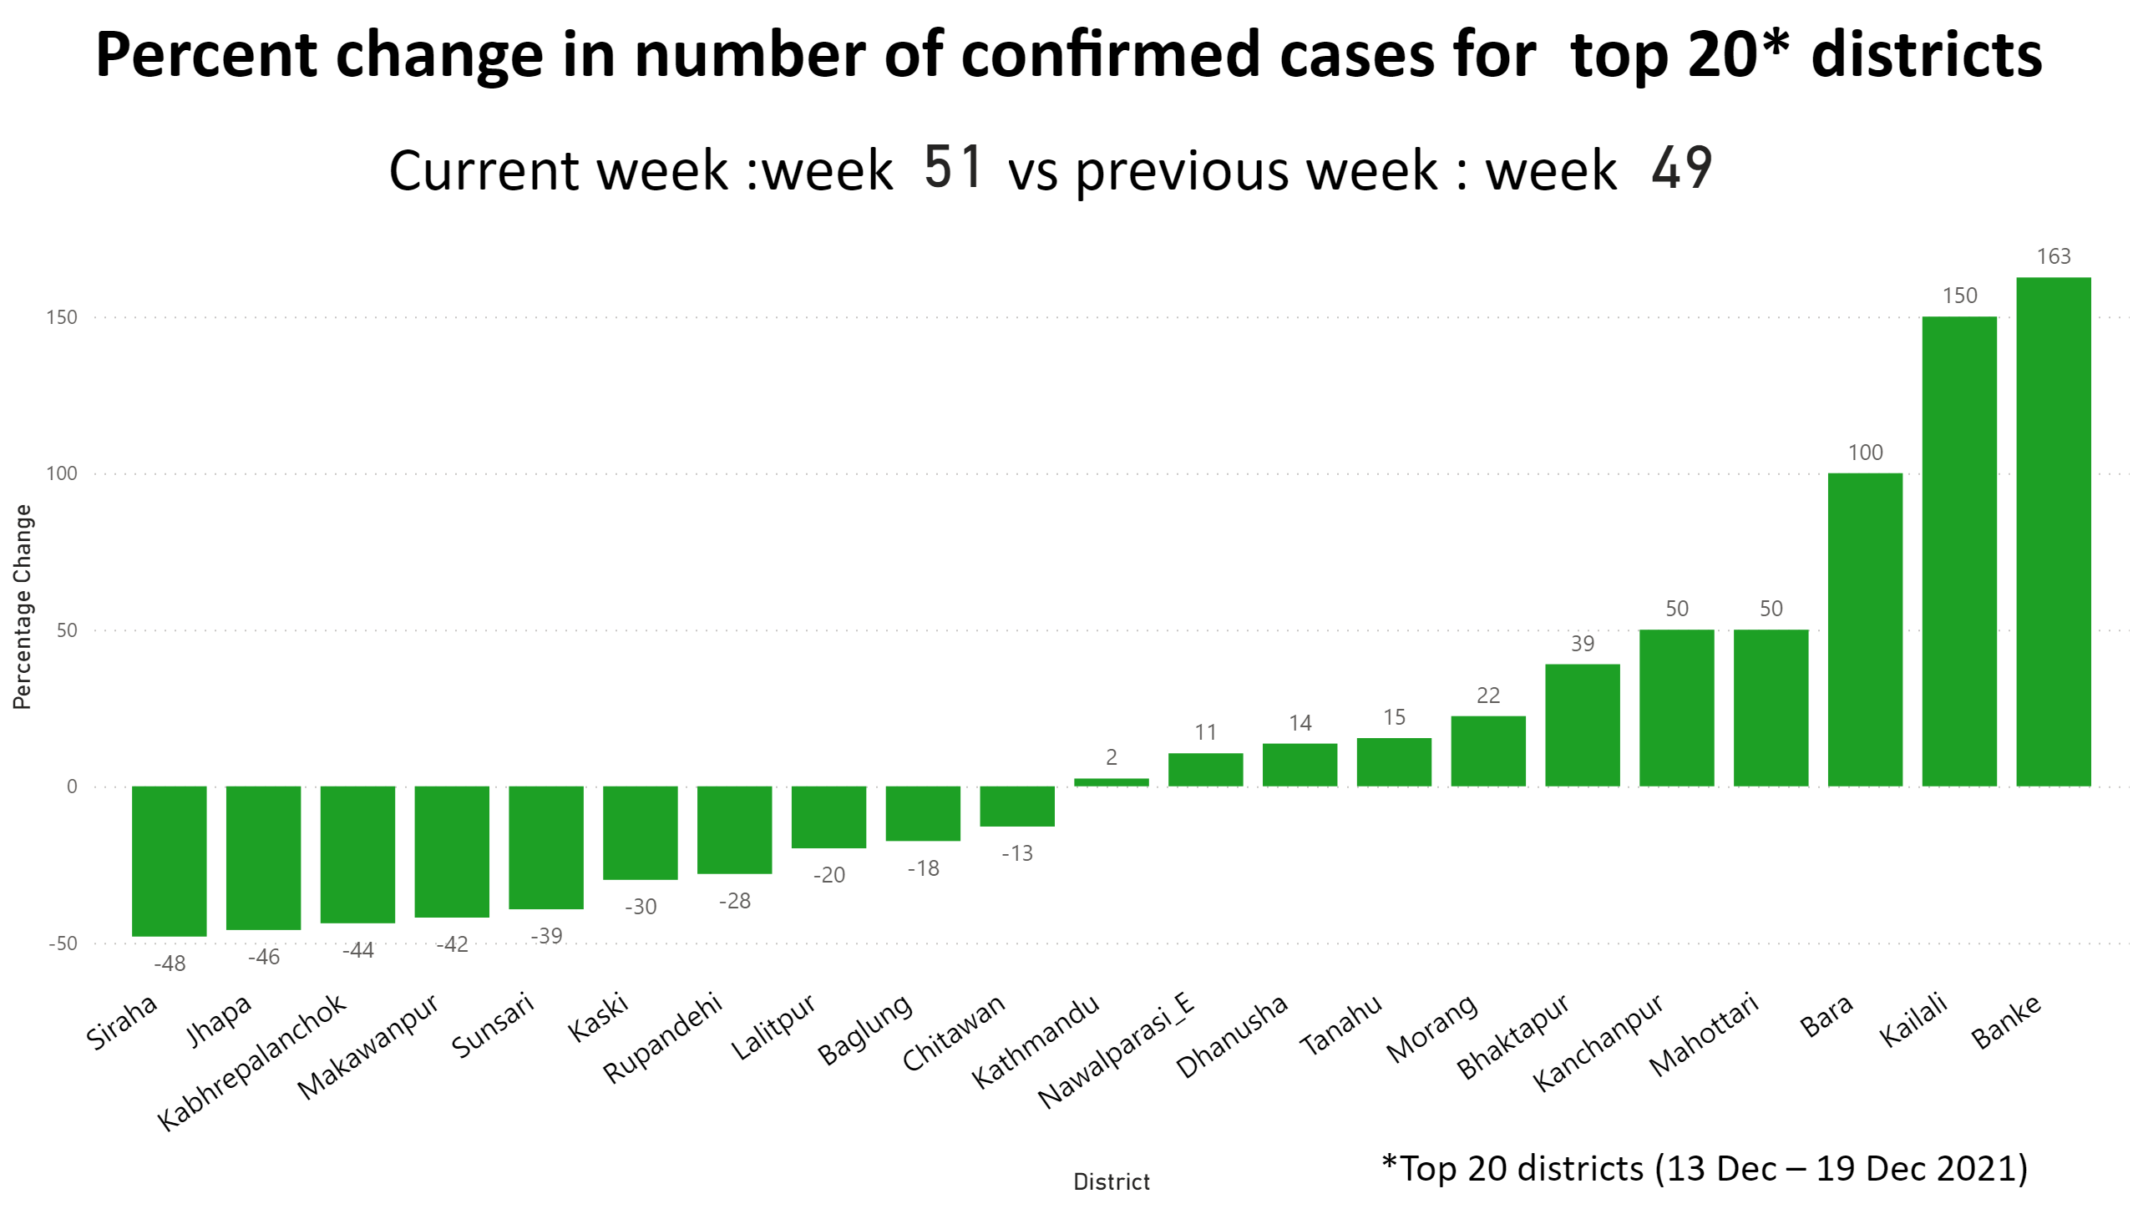
percent change districts
Notes:
clusteredColumnChart
No alt text provided
textbox
No alt text provided
textbox
No alt text provided
card
No alt text provided
card
No alt text provided
textbox
No alt text provided

Slide 13
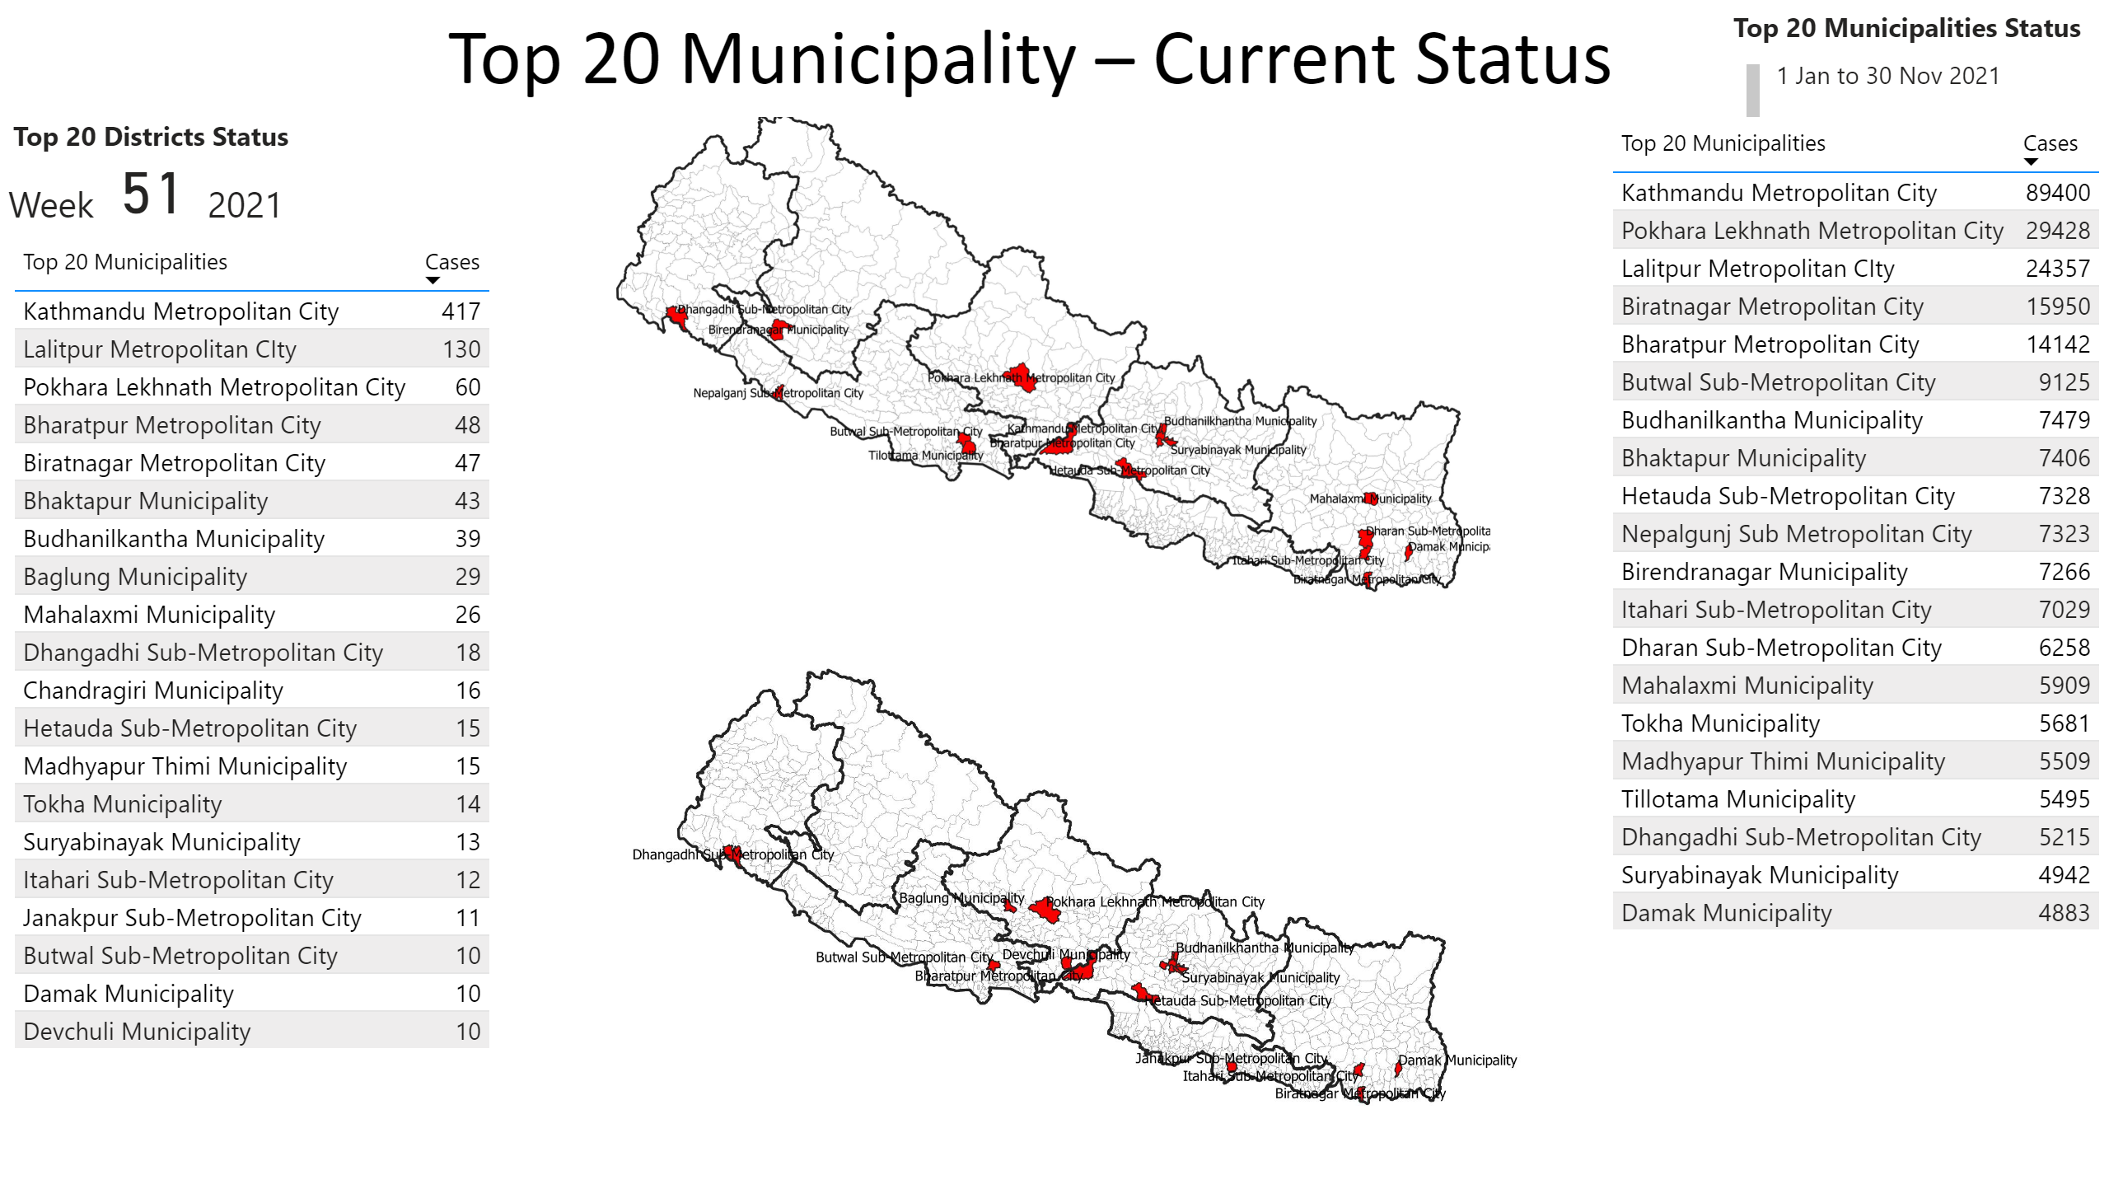
Top 20 Municipalities
Notes:
textbox
No alt text provided
tableEx
No alt text provided
card
No alt text provided
textbox
No alt text provided
textbox
No alt text provided
textbox
No alt text provided
image
No alt text provided
textbox
No alt text provided
textbox
No alt text provided
tableEx
No alt text provided
image
No alt text provided

Slide 14
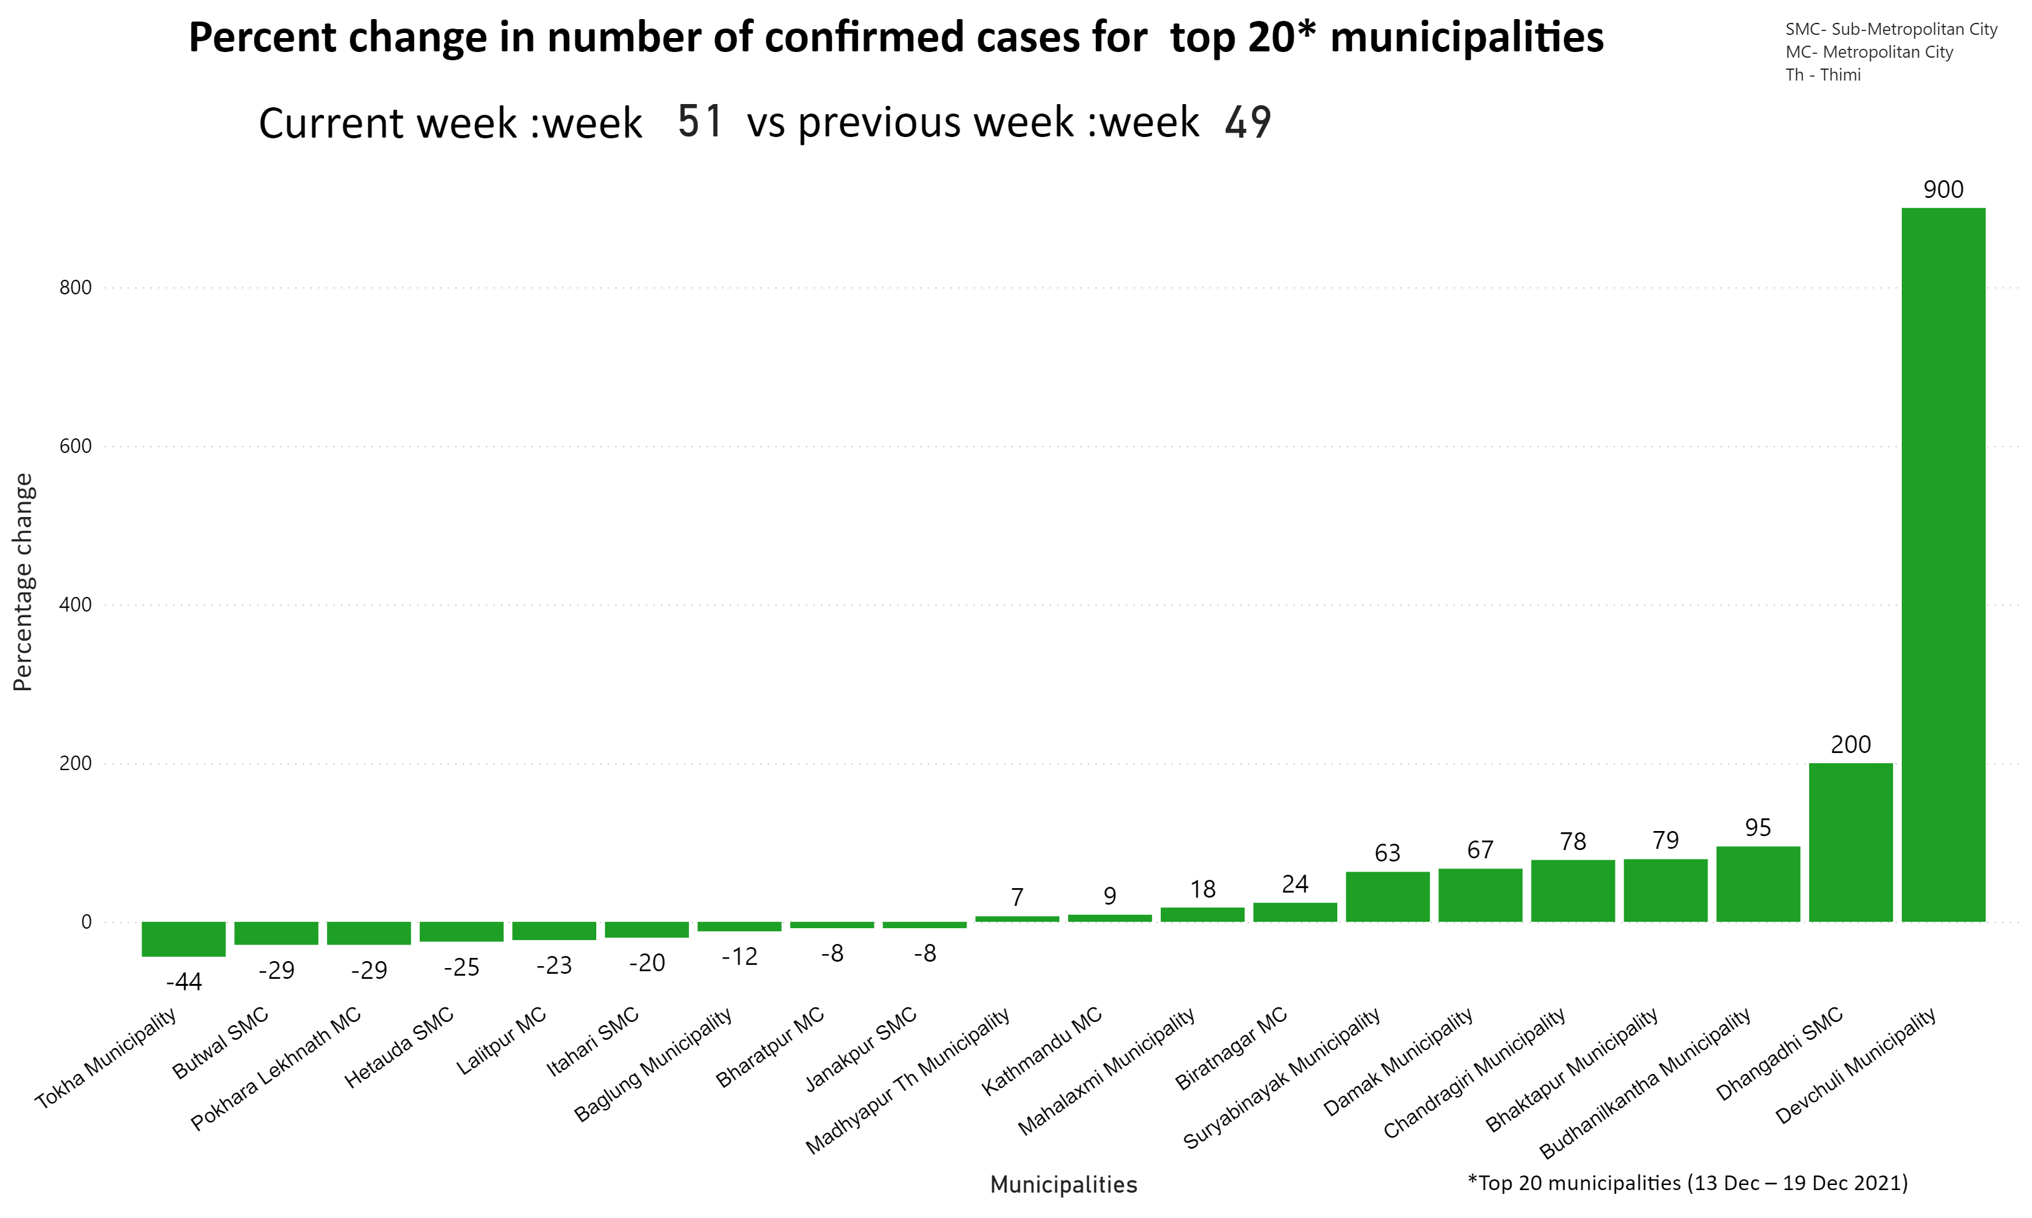
percent change mun
Notes:
textbox
No alt text provided
textbox
No alt text provided
card
No alt text provided
textbox
No alt text provided
card
No alt text provided
textbox
No alt text provided
clusteredColumnChart
No alt text provided
textbox
No alt text provided
textbox
No alt text provided

Slide 15
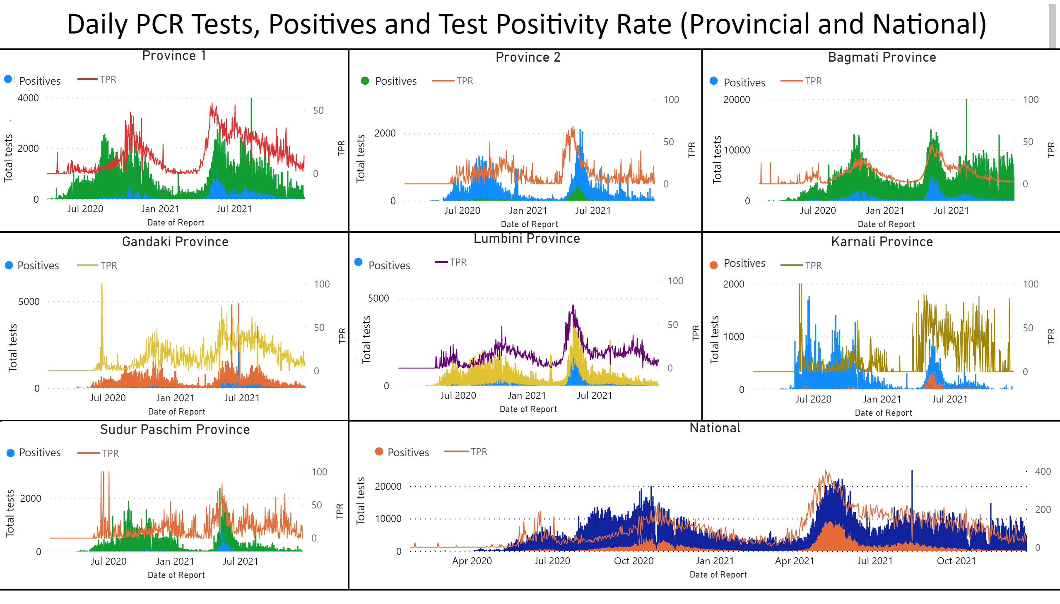
TPR
Notes:
textbox
No alt text provided
lineStackedColumnComboChart
No alt text provided
Bagmati Province
No alt text provided
Karnali Province
No alt text provided
Gandaki Province
No alt text provided
Province 2
No alt text provided
National
No alt text provided
textbox
No alt text provided
Province 1
No alt text provided
textbox
No alt text provided
textbox
No alt text provided
textbox
No alt text provided
textbox
No alt text provided
textbox
No alt text provided
textbox
No alt text provided
textbox
No alt text provided
textbox
No alt text provided
textbox
No alt text provided
textbox
No alt text provided
textbox
No alt text provided
textbox
No alt text provided
textbox
No alt text provided
textbox
No alt text provided
textbox
No alt text provided
textbox
No alt text provided
Lumbini Province
No alt text provided
shape
No alt text provided
shape
No alt text provided
shape
No alt text provided
shape
No alt text provided
shape
No alt text provided
shape
No alt text provided
textbox
No alt text provided
textbox
No alt text provided
Sudur Paschim Province
No alt text provided
textbox
No alt text provided
textbox
No alt text provided
shape
No alt text provided
shape
No alt text provided
shape
No alt text provided
shape
No alt text provided
shape
No alt text provided
shape
No alt text provided
shape
No alt text provided
textbox
No alt text provided
shape
No alt text provided

Slide 16
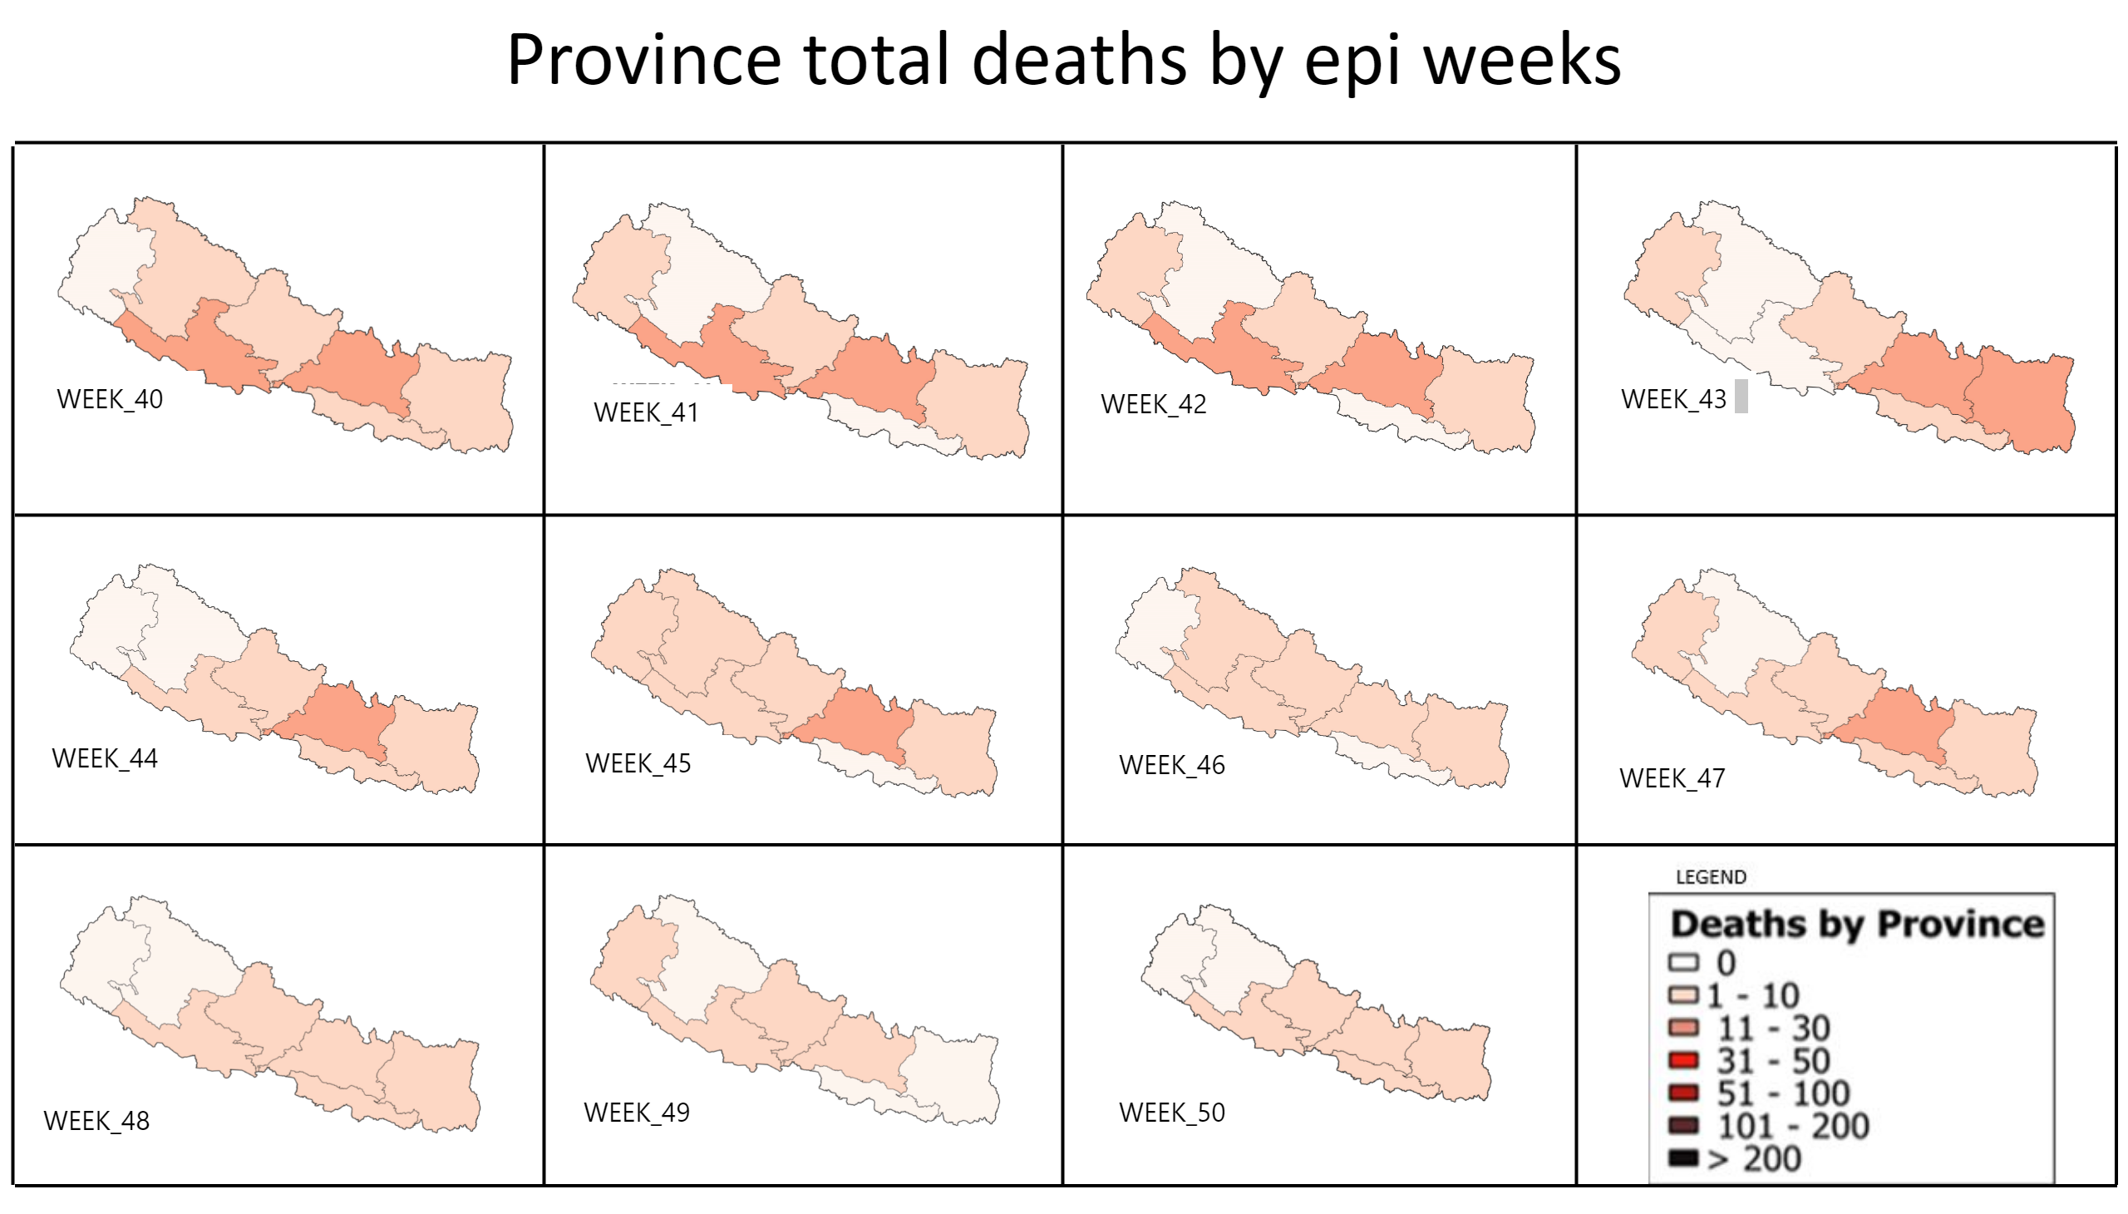
deaths by epi weeks
Notes:
textbox
No alt text provided
image
No alt text provided
textbox
No alt text provided
image
No alt text provided
textbox
No alt text provided
image
No alt text provided
textbox
No alt text provided
image
No alt text provided
textbox
No alt text provided
image
No alt text provided
textbox
No alt text provided
image
No alt text provided
textbox
No alt text provided
image
No alt text provided
shape
No alt text provided
shape
No alt text provided
shape
No alt text provided
shape
No alt text provided
shape
No alt text provided
shape
No alt text provided
textbox
No alt text provided
image
No alt text provided
shape
No alt text provided
shape
No alt text provided
shape
No alt text provided
textbox
No alt text provided
image
No alt text provided
textbox
No alt text provided
image
No alt text provided
textbox
No alt text provided
image
No alt text provided
image
No alt text provided
textbox
No alt text provided

Slide 17
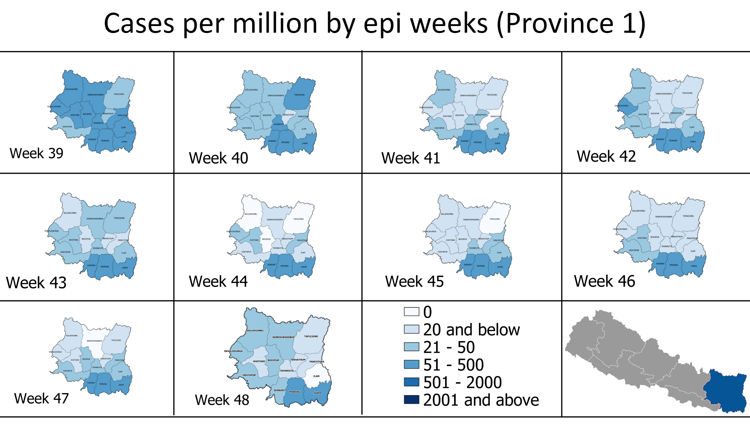
cpm (p1)
Notes:
shape
No alt text provided
shape
No alt text provided
shape
No alt text provided
shape
No alt text provided
shape
No alt text provided
textbox
No alt text provided
shape
No alt text provided
image
No alt text provided
image
No alt text provided
image
No alt text provided
image
No alt text provided
image
No alt text provided
image
No alt text provided
image
No alt text provided
image
No alt text provided
image
No alt text provided
image
No alt text provided
shape
No alt text provided
image
No alt text provided
image
No alt text provided

Slide 18
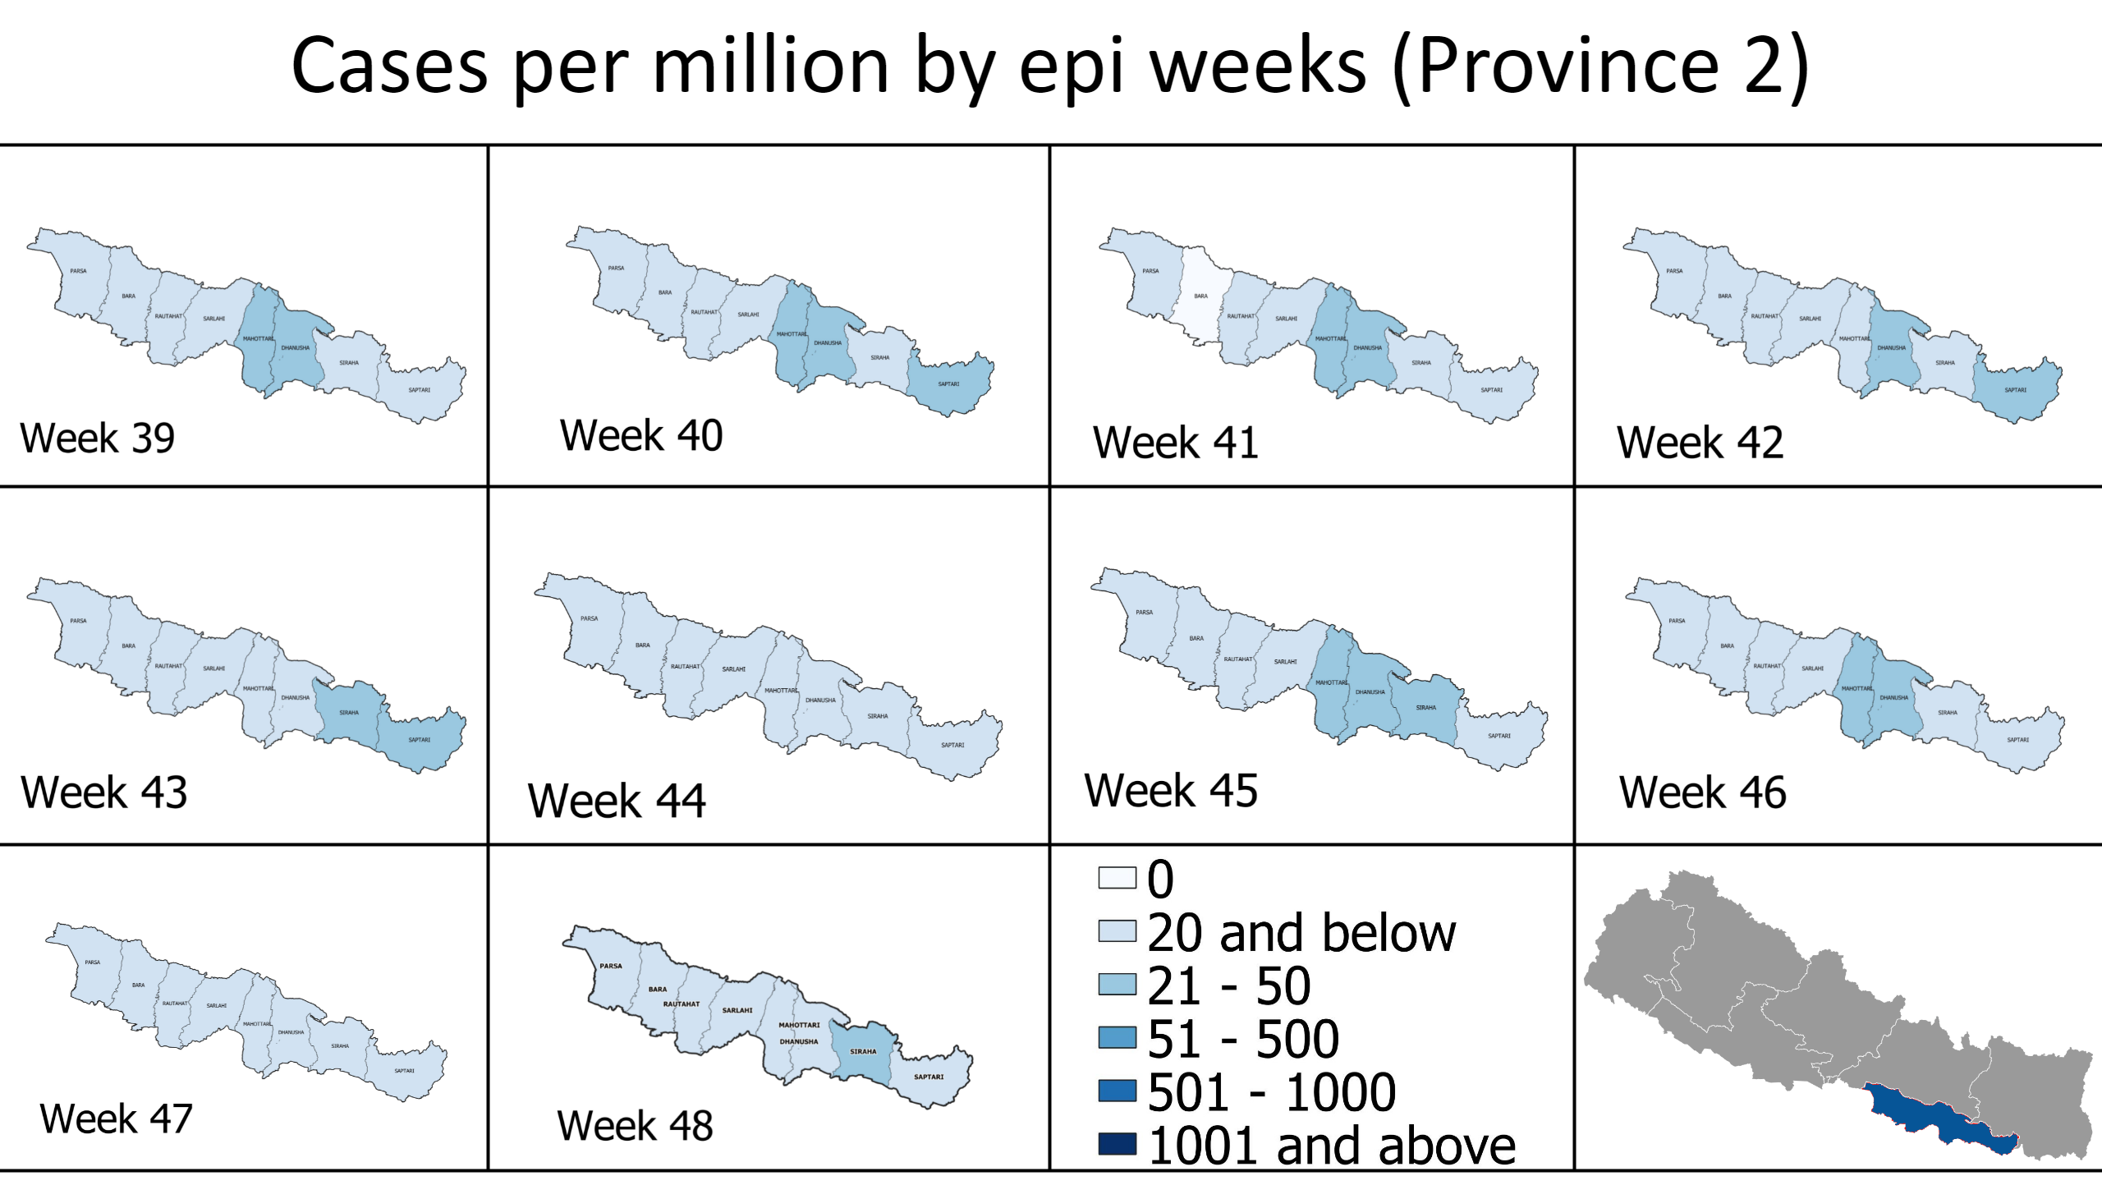
cpm (p2)
Notes:
shape
No alt text provided
shape
No alt text provided
shape
No alt text provided
shape
No alt text provided
shape
No alt text provided
textbox
No alt text provided
shape
No alt text provided
image
No alt text provided
image
No alt text provided
image
No alt text provided
image
No alt text provided
image
No alt text provided
image
No alt text provided
image
No alt text provided
image
No alt text provided
image
No alt text provided
image
No alt text provided
shape
No alt text provided
image
No alt text provided
image
No alt text provided

Slide 19
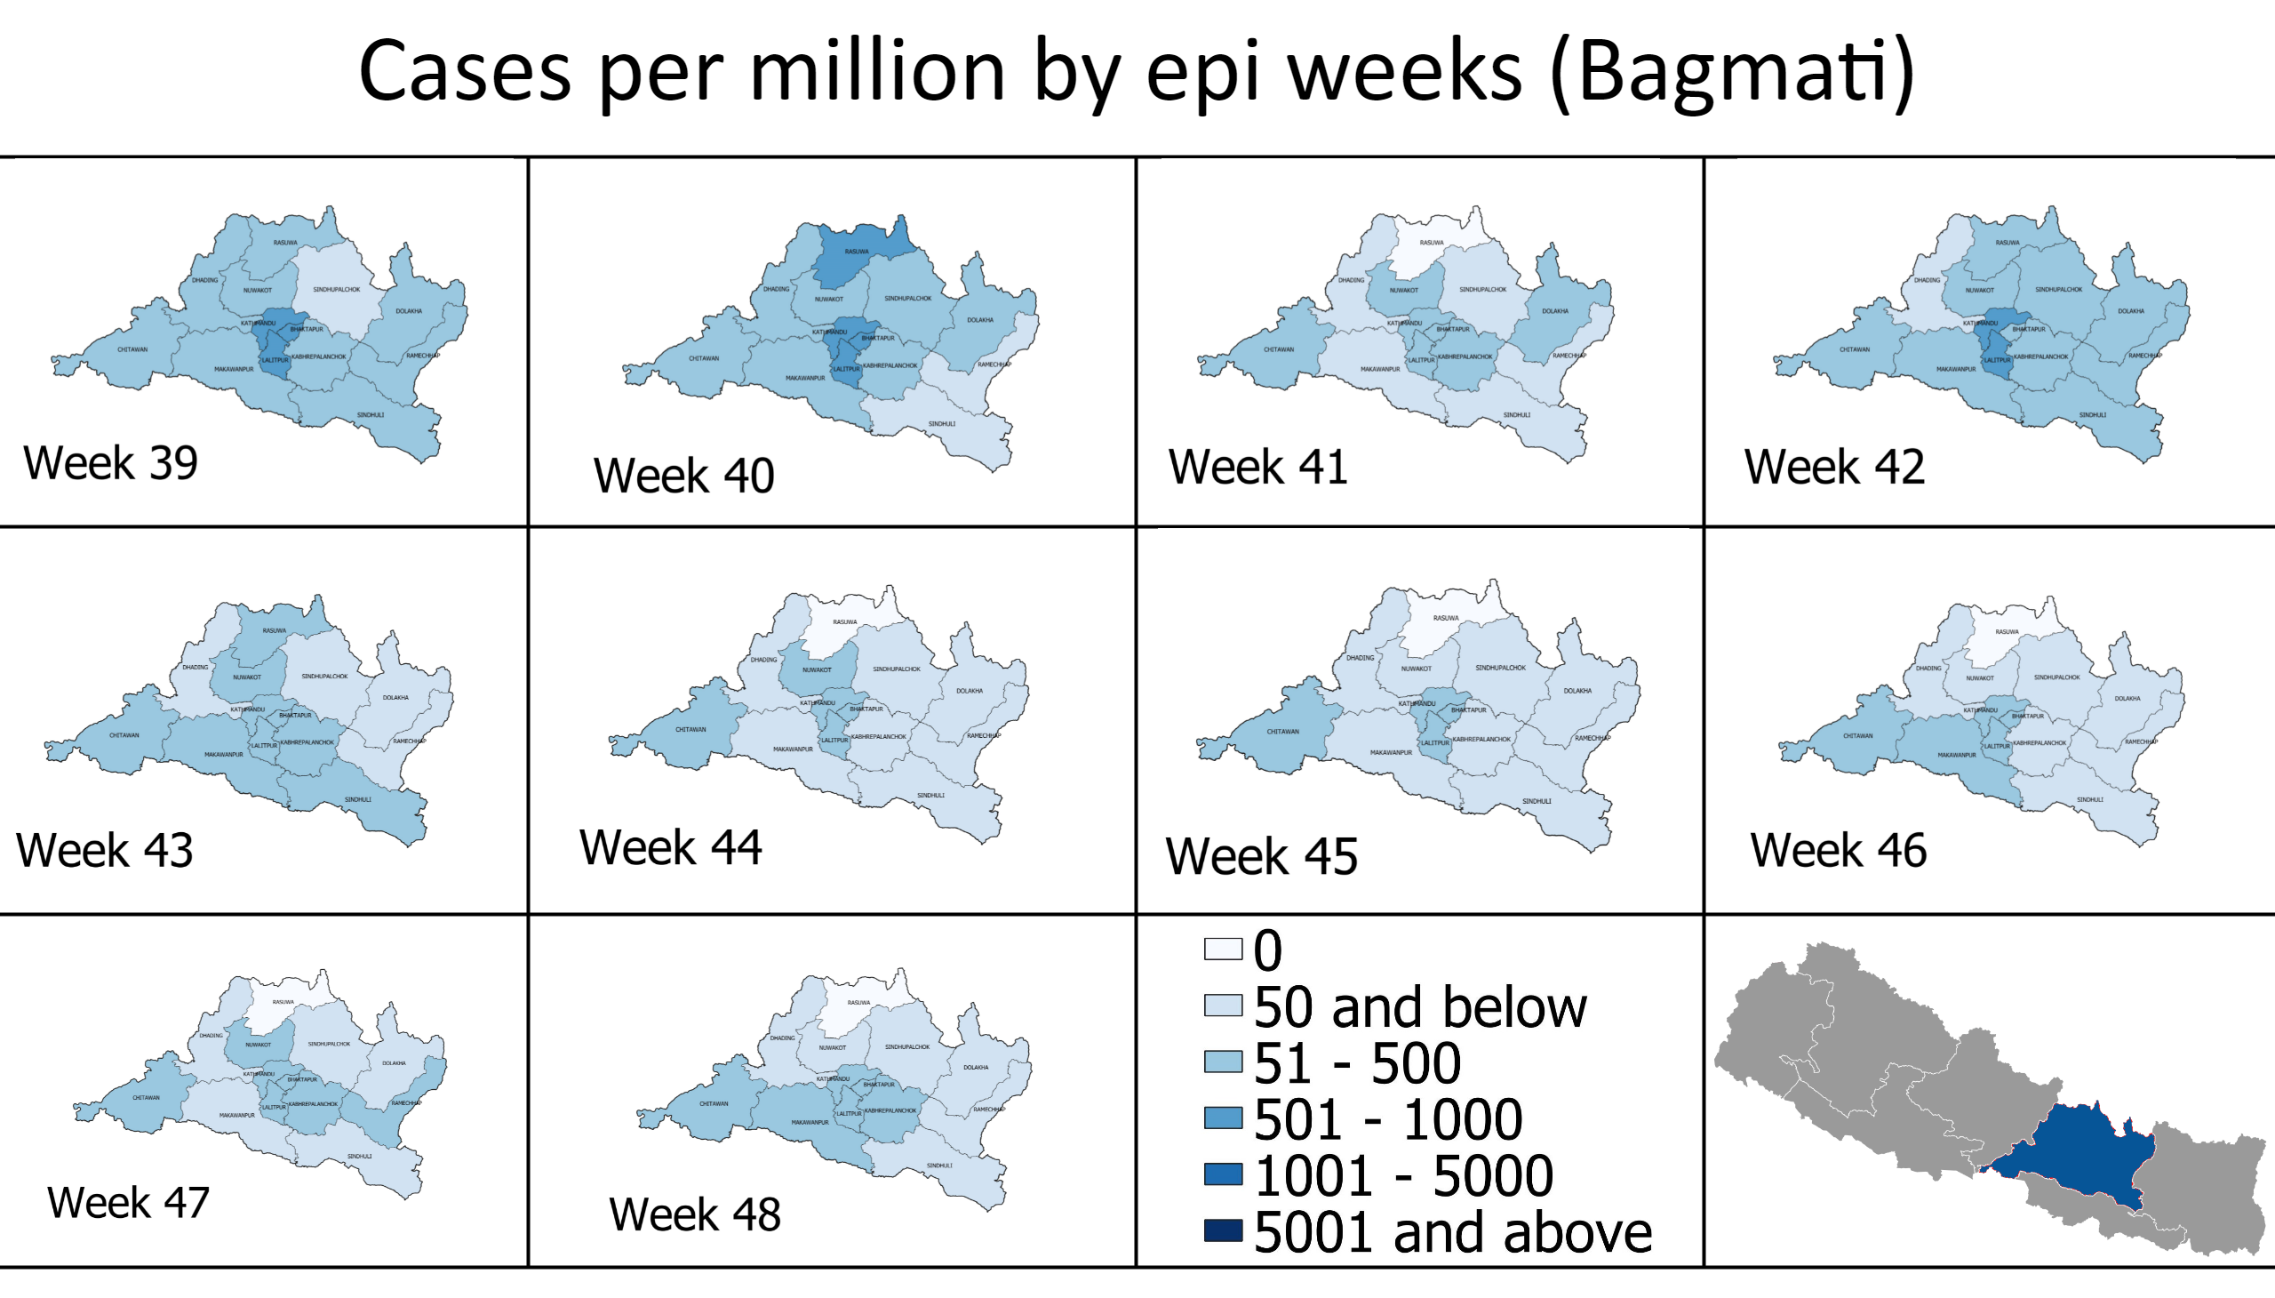
cpm (p3)
Notes:
shape
No alt text provided
shape
No alt text provided
shape
No alt text provided
shape
No alt text provided
shape
No alt text provided
textbox
No alt text provided
shape
No alt text provided
image
No alt text provided
image
No alt text provided
image
No alt text provided
image
No alt text provided
image
No alt text provided
image
No alt text provided
image
No alt text provided
image
No alt text provided
image
No alt text provided
image
No alt text provided
shape
No alt text provided
image
No alt text provided
image
No alt text provided

Slide 20
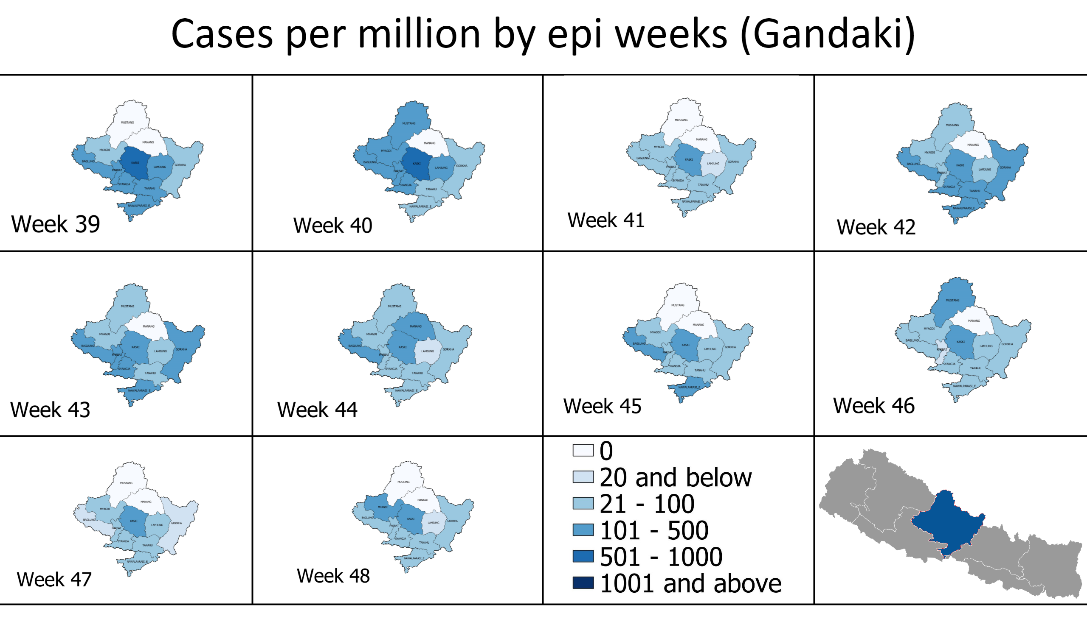
cpm (p4)
Notes:
shape
No alt text provided
shape
No alt text provided
shape
No alt text provided
shape
No alt text provided
shape
No alt text provided
textbox
No alt text provided
shape
No alt text provided
image
No alt text provided
image
No alt text provided
image
No alt text provided
image
No alt text provided
image
No alt text provided
image
No alt text provided
image
No alt text provided
image
No alt text provided
image
No alt text provided
image
No alt text provided
shape
No alt text provided
image
No alt text provided
image
No alt text provided

Slide 21
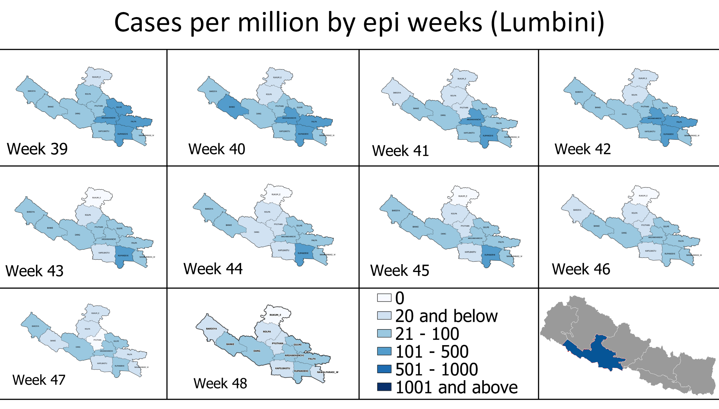
cpm (p5)
Notes:
shape
No alt text provided
shape
No alt text provided
shape
No alt text provided
shape
No alt text provided
shape
No alt text provided
textbox
No alt text provided
shape
No alt text provided
image
No alt text provided
image
No alt text provided
image
No alt text provided
image
No alt text provided
image
No alt text provided
image
No alt text provided
image
No alt text provided
image
No alt text provided
image
No alt text provided
image
No alt text provided
shape
No alt text provided
image
No alt text provided
image
No alt text provided

Slide 22
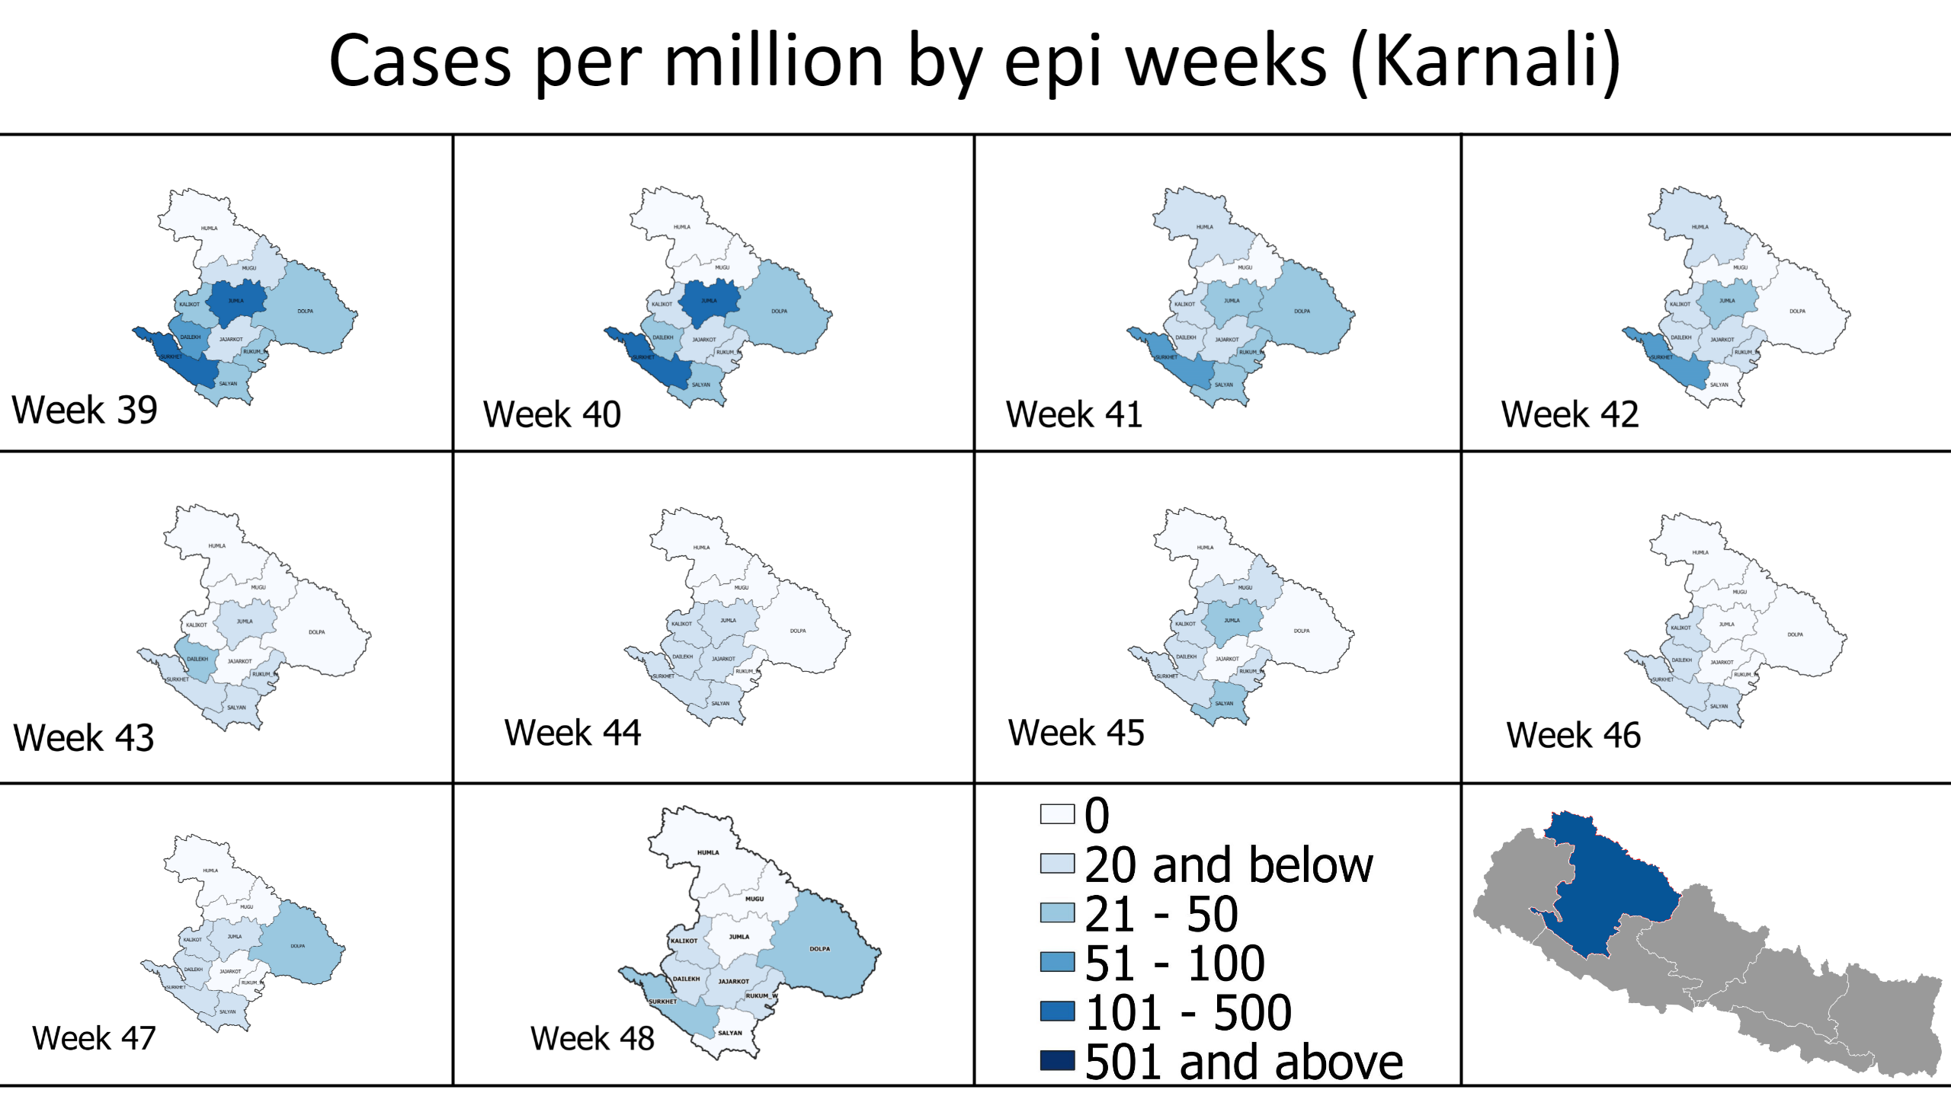
cpm (p6)
Notes:
shape
No alt text provided
shape
No alt text provided
shape
No alt text provided
shape
No alt text provided
shape
No alt text provided
textbox
No alt text provided
shape
No alt text provided
image
No alt text provided
image
No alt text provided
image
No alt text provided
image
No alt text provided
image
No alt text provided
image
No alt text provided
image
No alt text provided
image
No alt text provided
image
No alt text provided
image
No alt text provided
shape
No alt text provided
image
No alt text provided
image
No alt text provided

Slide 23
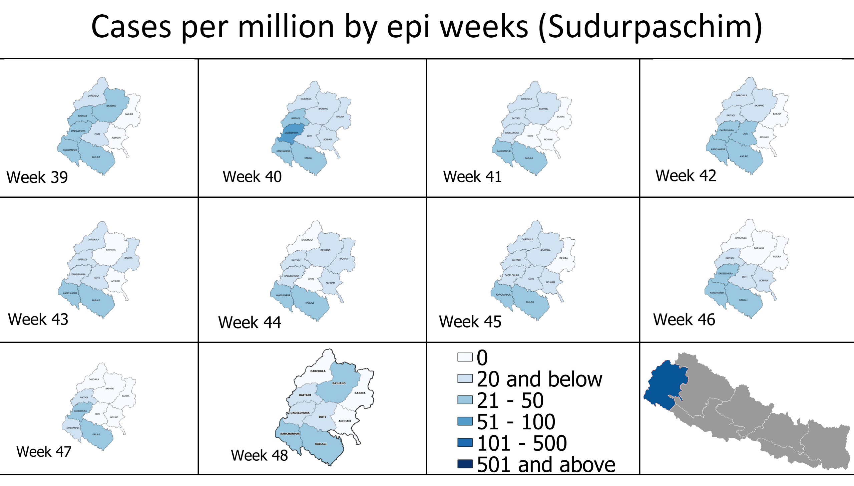
cpm (p7)
Notes:
shape
No alt text provided
shape
No alt text provided
shape
No alt text provided
shape
No alt text provided
shape
No alt text provided
textbox
No alt text provided
shape
No alt text provided
image
No alt text provided
image
No alt text provided
image
No alt text provided
image
No alt text provided
image
No alt text provided
image
No alt text provided
image
No alt text provided
image
No alt text provided
image
No alt text provided
image
No alt text provided
shape
No alt text provided
image
No alt text provided
image
No alt text provided

Slide 24
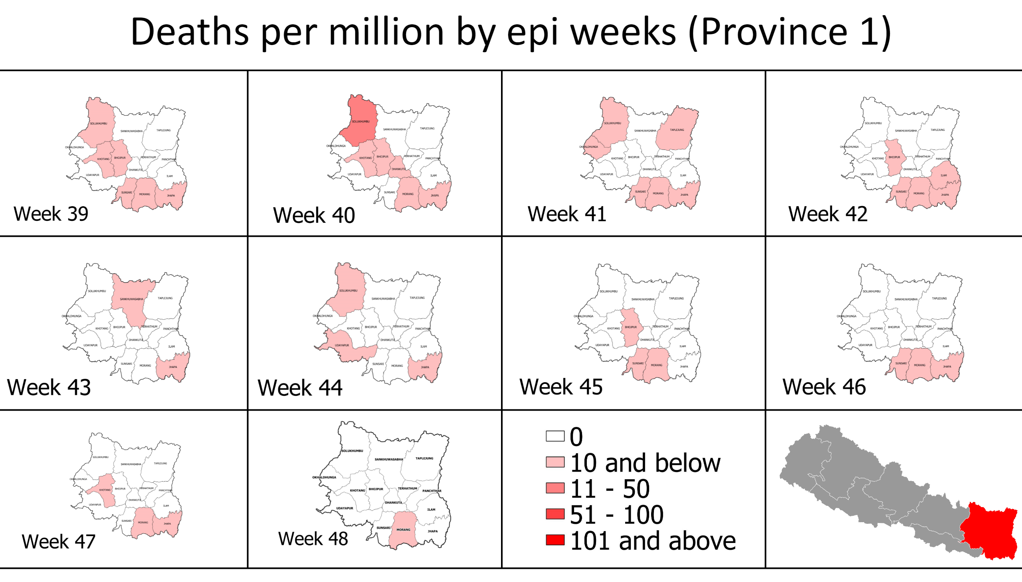
dpm (p1)
Notes:
shape
No alt text provided
shape
No alt text provided
shape
No alt text provided
shape
No alt text provided
shape
No alt text provided
textbox
No alt text provided
shape
No alt text provided
image
No alt text provided
image
No alt text provided
image
No alt text provided
image
No alt text provided
image
No alt text provided
image
No alt text provided
image
No alt text provided
image
No alt text provided
image
No alt text provided
image
No alt text provided
shape
No alt text provided
image
No alt text provided
image
No alt text provided

Slide 25
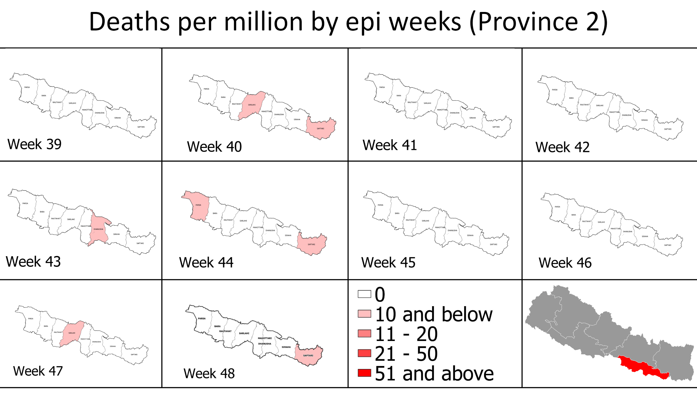
dpm (p2)
Notes:
shape
No alt text provided
shape
No alt text provided
shape
No alt text provided
shape
No alt text provided
shape
No alt text provided
textbox
No alt text provided
shape
No alt text provided
image
No alt text provided
image
No alt text provided
image
No alt text provided
image
No alt text provided
image
No alt text provided
image
No alt text provided
image
No alt text provided
image
No alt text provided
image
No alt text provided
image
No alt text provided
shape
No alt text provided
image
No alt text provided
image
No alt text provided

Slide 26
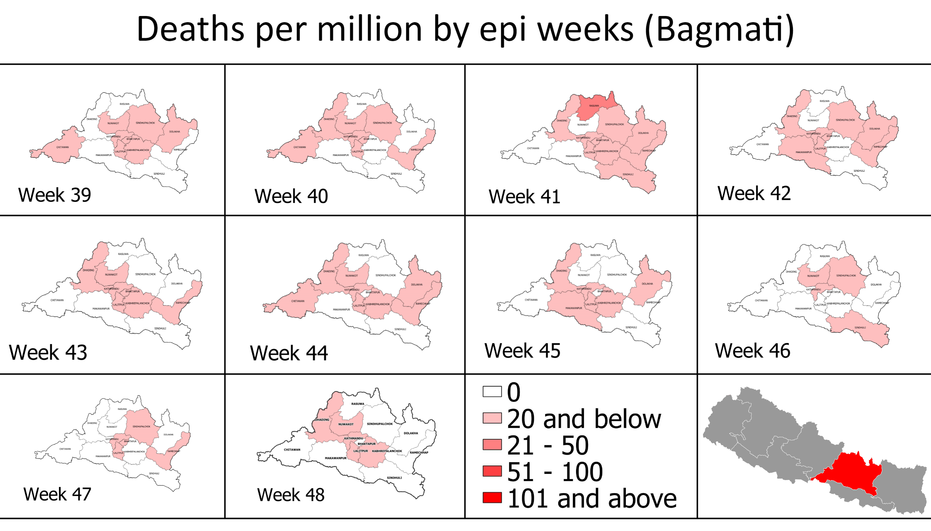
dpm (p3)
Notes:
shape
No alt text provided
shape
No alt text provided
shape
No alt text provided
shape
No alt text provided
shape
No alt text provided
textbox
No alt text provided
shape
No alt text provided
image
No alt text provided
image
No alt text provided
image
No alt text provided
image
No alt text provided
image
No alt text provided
image
No alt text provided
image
No alt text provided
image
No alt text provided
image
No alt text provided
image
No alt text provided
shape
No alt text provided
image
No alt text provided
image
No alt text provided

Slide 27
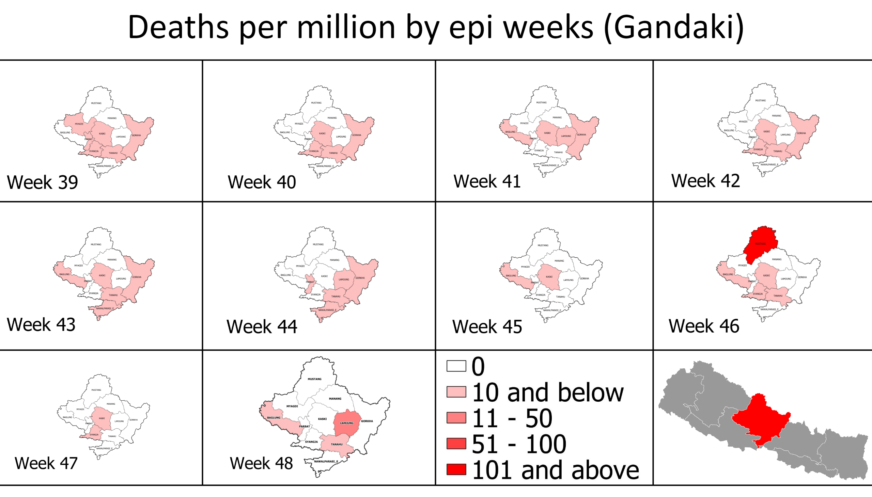
dpm (p4)
Notes:
shape
No alt text provided
shape
No alt text provided
shape
No alt text provided
shape
No alt text provided
shape
No alt text provided
textbox
No alt text provided
shape
No alt text provided
image
No alt text provided
image
No alt text provided
image
No alt text provided
image
No alt text provided
image
No alt text provided
image
No alt text provided
image
No alt text provided
image
No alt text provided
image
No alt text provided
image
No alt text provided
shape
No alt text provided
image
No alt text provided
image
No alt text provided

Slide 28
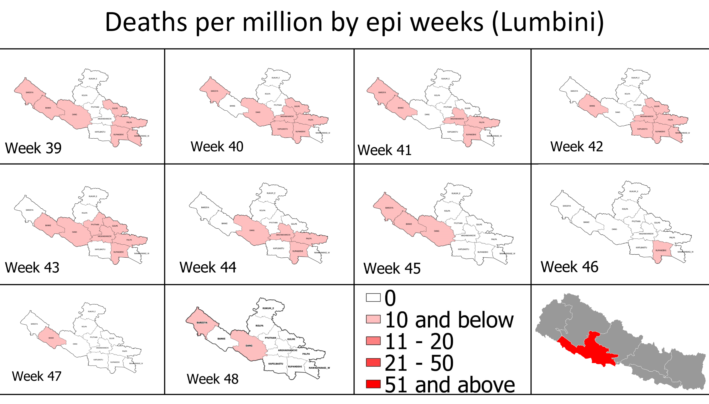
dpm (p5)
Notes:
shape
No alt text provided
shape
No alt text provided
shape
No alt text provided
shape
No alt text provided
shape
No alt text provided
textbox
No alt text provided
shape
No alt text provided
image
No alt text provided
image
No alt text provided
image
No alt text provided
image
No alt text provided
image
No alt text provided
image
No alt text provided
image
No alt text provided
image
No alt text provided
image
No alt text provided
image
No alt text provided
shape
No alt text provided
image
No alt text provided
image
No alt text provided

Slide 29
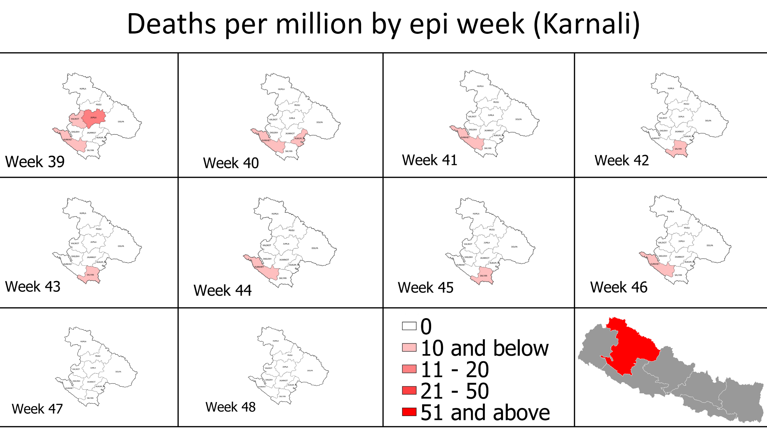
dpm (p6)
Notes:
shape
No alt text provided
shape
No alt text provided
shape
No alt text provided
shape
No alt text provided
shape
No alt text provided
textbox
No alt text provided
shape
No alt text provided
image
No alt text provided
image
No alt text provided
image
No alt text provided
image
No alt text provided
image
No alt text provided
image
No alt text provided
image
No alt text provided
image
No alt text provided
image
No alt text provided
image
No alt text provided
shape
No alt text provided
image
No alt text provided
image
No alt text provided

Slide 30
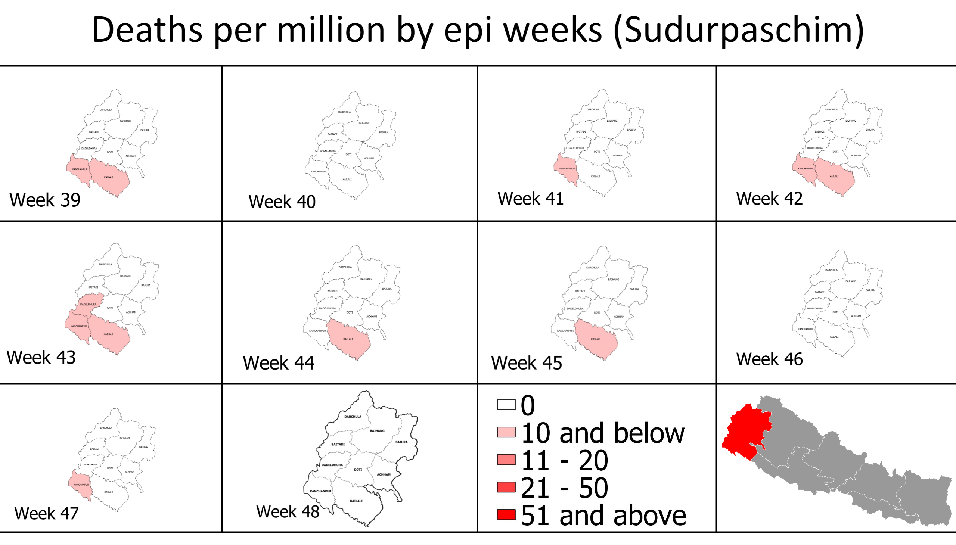
dpm (p7)
Notes:
shape
No alt text provided
shape
No alt text provided
shape
No alt text provided
shape
No alt text provided
shape
No alt text provided
textbox
No alt text provided
shape
No alt text provided
image
No alt text provided
image
No alt text provided
image
No alt text provided
image
No alt text provided
image
No alt text provided
image
No alt text provided
image
No alt text provided
image
No alt text provided
image
No alt text provided
image
No alt text provided
shape
No alt text provided
image
No alt text provided
image
No alt text provided

Slide 31
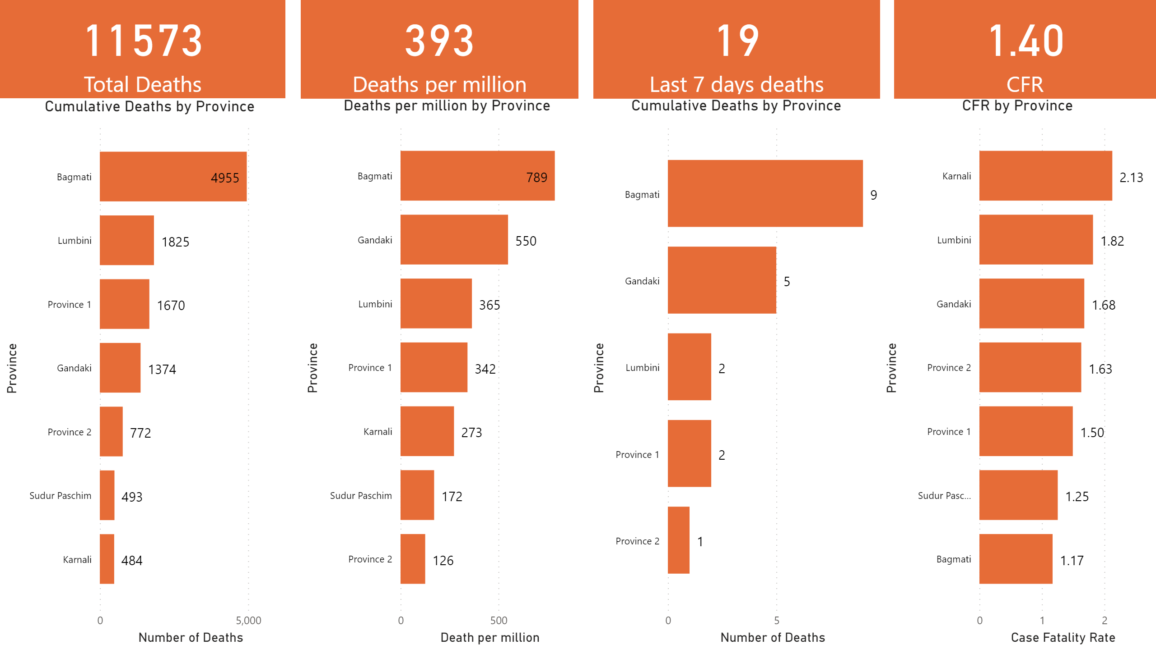
death province
Notes:
card
No alt text provided
card
No alt text provided
card
No alt text provided
Deaths per million by Province
No alt text provided
Cumulative Deaths by Province
No alt text provided
card
No alt text provided
CFR by Province
No alt text provided
Cumulative Deaths by Province
No alt text provided

Slide 32
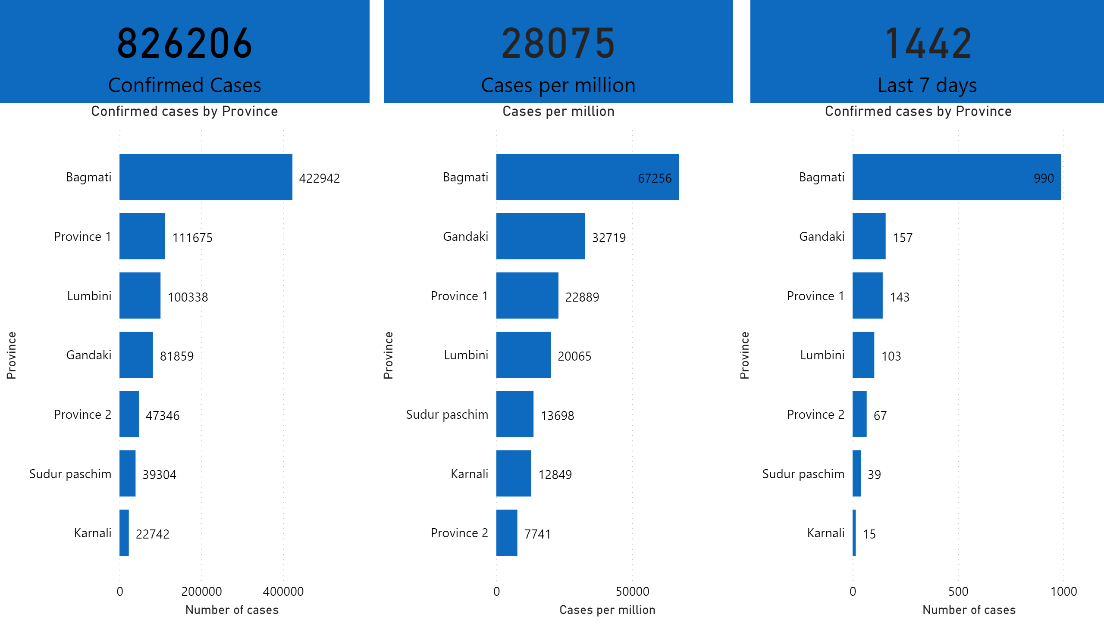
Confirmed cases province
Notes:
Confirmed cases by Province
No alt text provided
Confirmed cases by Province
No alt text provided
Cases per million
No alt text provided
card
No alt text provided
card
No alt text provided
card
No alt text provided

Slide 33
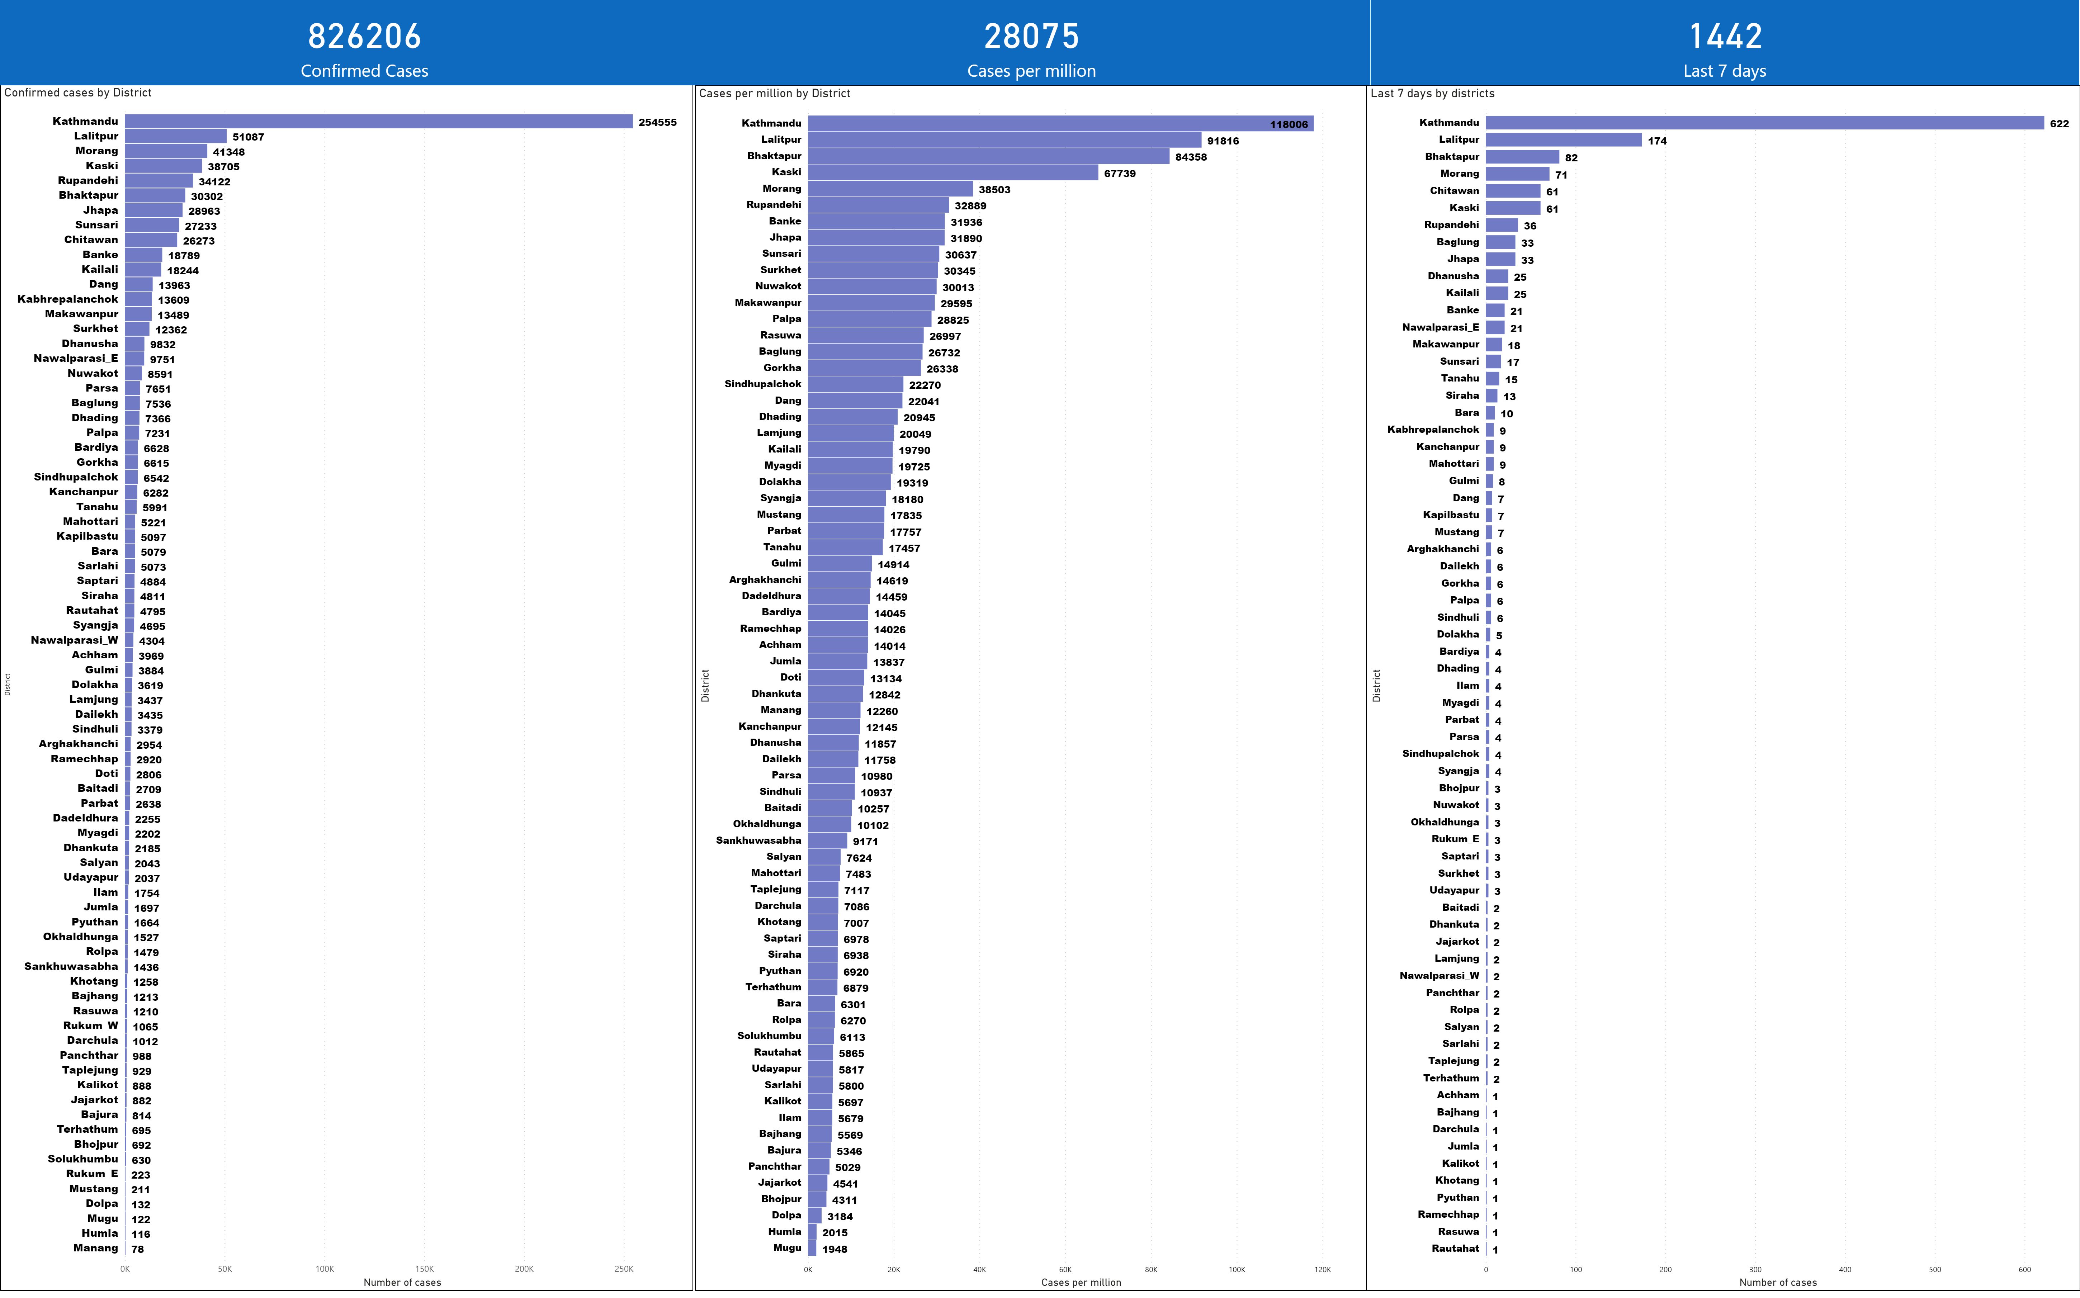
confirmed cases district
Notes:
Confirmed cases by District
No alt text provided
Last 7 days by districts
No alt text provided
card
No alt text provided
card
No alt text provided
card
No alt text provided
clusteredBarChart
No alt text provided

Slide 34
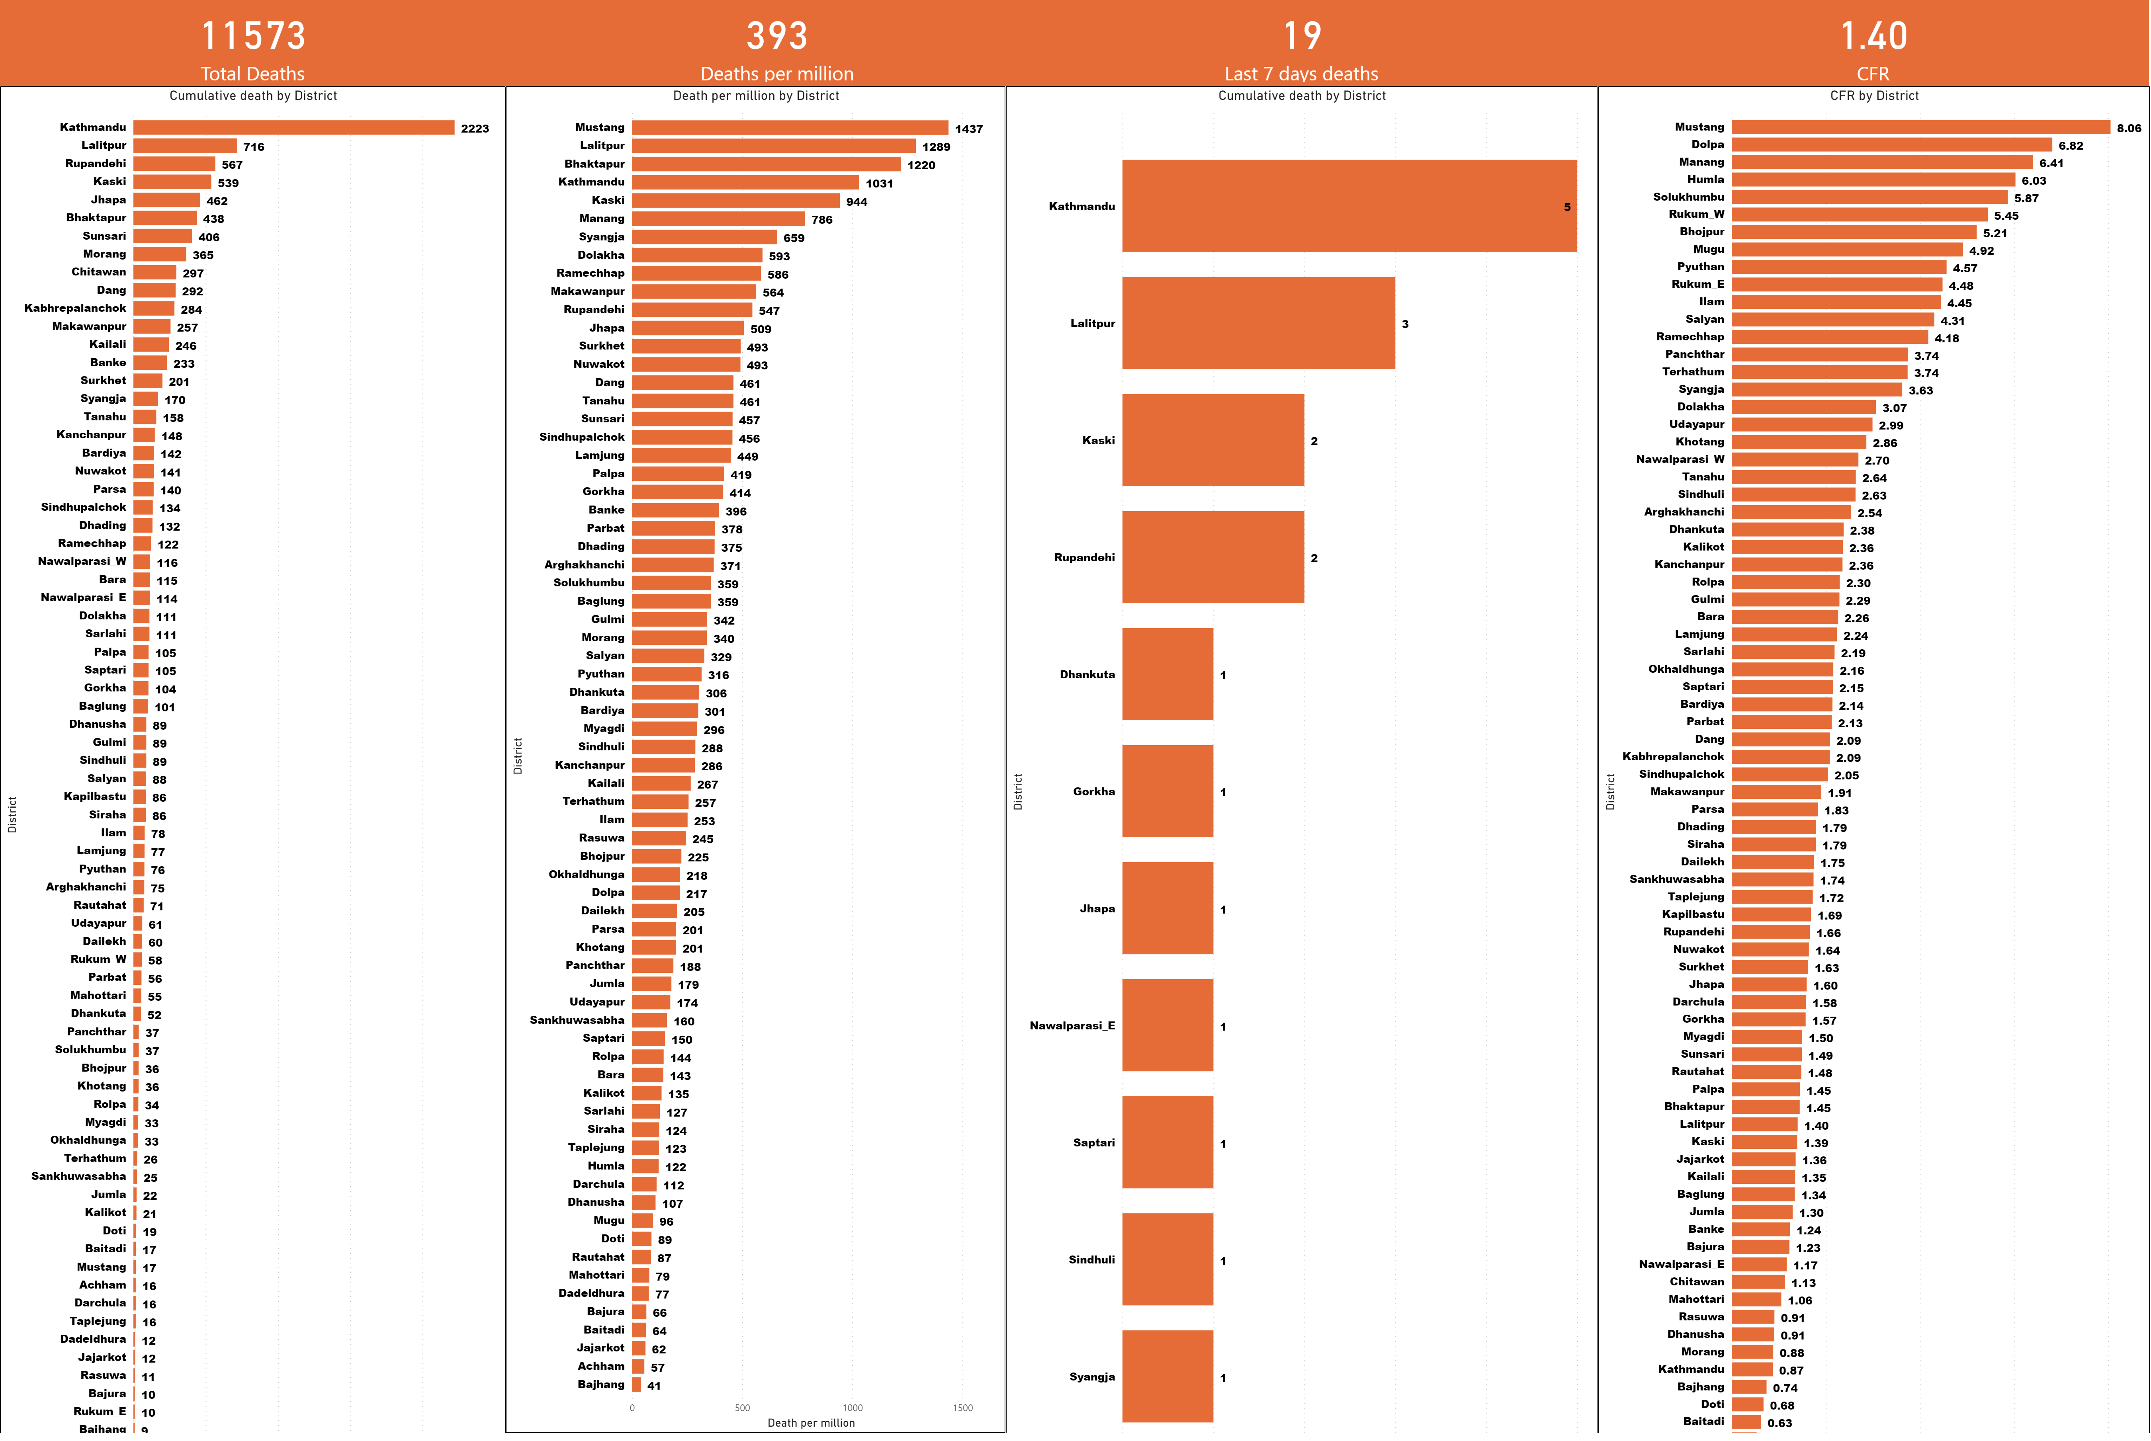
death district
Notes:
Cumulative death by District
No alt text provided
Cumulative death by District
No alt text provided
card
No alt text provided
Death per million by District
No alt text provided
CFR by District
No alt text provided
card
No alt text provided
card
No alt text provided
card
No alt text provided

Slide 35
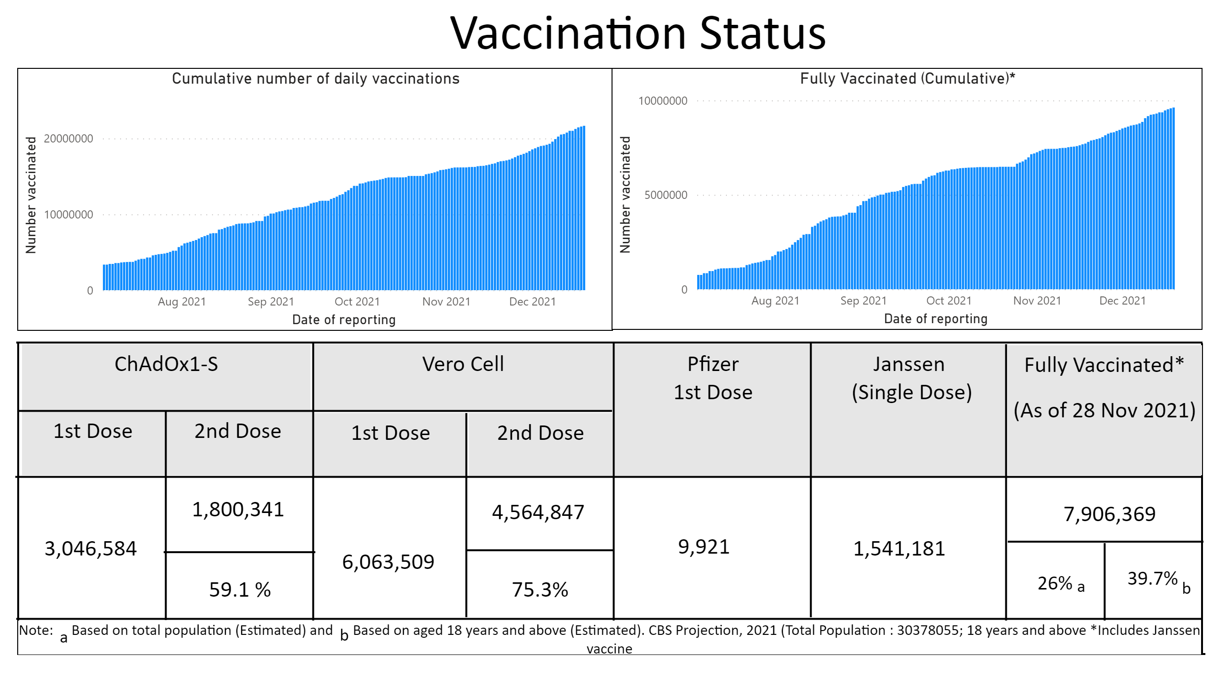
vaccination
Notes:
Cumulative number of daily vaccinations
No alt text provided
Fully Vaccinated (Cumulative)*
No alt text provided
shape
No alt text provided
shape
No alt text provided
shape
No alt text provided
shape
No alt text provided
shape
No alt text provided
shape
No alt text provided
shape
No alt text provided
shape
No alt text provided
shape
No alt text provided
shape
No alt text provided
shape
No alt text provided
shape
No alt text provided
shape
No alt text provided
shape
No alt text provided
shape
No alt text provided
textbox
No alt text provided
textbox
No alt text provided
textbox
No alt text provided
textbox
No alt text provided
textbox
No alt text provided
textbox
No alt text provided
textbox
No alt text provided
textbox
No alt text provided
textbox
No alt text provided
textbox
No alt text provided
textbox
No alt text provided
textbox
No alt text provided
textbox
No alt text provided
textbox
No alt text provided
textbox
No alt text provided
textbox
No alt text provided
textbox
No alt text provided
shape
No alt text provided
textbox
No alt text provided
shape
No alt text provided
textbox
No alt text provided
textbox
No alt text provided
shape
No alt text provided
shape
No alt text provided
shape
No alt text provided
shape
No alt text provided
shape
No alt text provided
shape
No alt text provided

